Slide 1
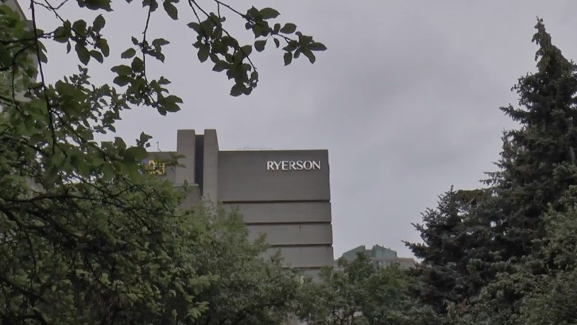
The Construction of Disability in Childhood
Interactive Activity

Slide 2
A child/student in your program/class has had two combined visits with a speech therapist and an occupational therapist from a child treatment center. The mother was referred to this agency by her family doctor. After a lengthy time on a waitlist, the child/student got a spot in a childcare centre, and the therapeutic interventions stopped.
Notes:
A child/student in your program/class has had two combined visits with a speech therapist and an occupational therapist from a child treatment center. The mother was referred to this agency by her family doctor. After a lengthy time on a waitlist, the child/student got a spot in a childcare centre, and the therapeutic interventions stopped.

Slide 3
A mother and child/student attended an Ontario Early Years Centre (OEYC) where the child/student was referred for a language assessment. The child/student was put on a waitlist for speech and language services. After several months, the child/student with his mother, attended 5 sessions of speech therapy services in a group with 5 other children/students.
Notes:
A mother and child/student attended an Ontario Early Years Centre (OEYC) where the child/student was referred for a language assessment. The child/student was put on a waitlist for speech and language services. After several months, the child/student with his mother, attended 5 sessions of speech therapy services in a group with 5 other children/students.

Slide 4
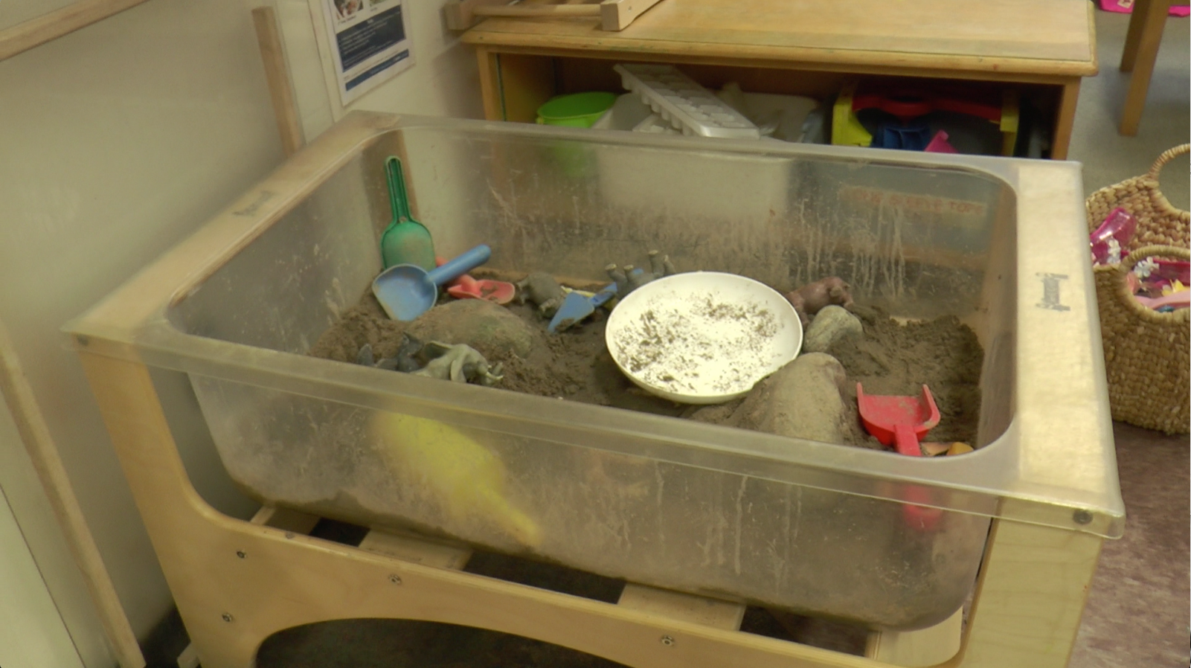
A mother has concerns about her son’s dental health. She has a referral for a specialist paediatric dentist because the son will not go to a regular dentist. She is not sure what is happening with this referral because her doctor said she would call the dentist. The mother has not heard anything for 3 months.
Notes:
A mother has concerns about her son’s dental health. She has a referral for a specialist paediatric dentist because the son will not go to a regular dentist. She is not sure what is happening with this referral because her doctor said she would call the dentist. The mother has not heard anything for 3 months.

Slide 5
The child/student has been waiting for about 8 months to get autism services. The mother has been told that the waitlist is usually 1.5 years to get Applied Behaviour Analysis (ABA) services, and 2 years for Intensive Behavioural Intervention (IBI).
Notes:
The child/student has been waiting for about 8 months to get autism services. The mother has been told that the waitlist is usually 1.5 years to get Applied Behaviour Analysis (ABA) services, and 2 years for Intensive Behavioural Intervention (IBI).

Slide 6
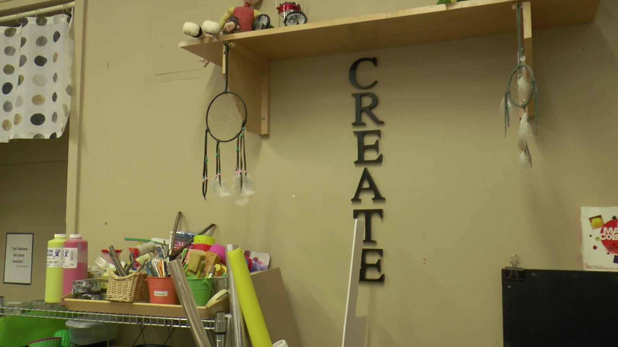
A family is getting a Special Services at Home grant. They get $300 per month to pay for a caregiver to come into their home, or to send their son to a specialized program such as a camp, or recreational activity.
Notes:
A family is getting a Special Services at Home grant. They get $300 per month to pay for a caregiver to come into their home, or to send their son to a specialized program such as a camp, or recreational activity.

Slide 7
Two parents of a child/student in your program/class are both unemployed and collecting Ontario Works. They have been on a waitlist for subsidized housing for over two years.
Notes:
Two parents of a child/student in your program/class are both unemployed and collecting Ontario Works. They have been on a waitlist for subsidized housing for over two years.

Slide 8
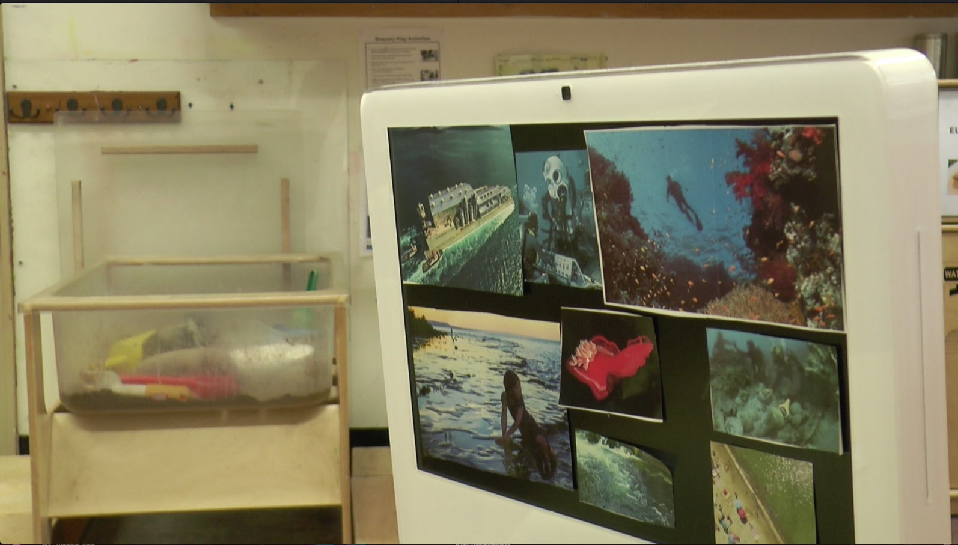
A family of a child/student in your class/program is Ukrainian and the parents have lived in Canada since just before their son was born. They speak Russian at home, but they feel they should speak English with their son because of his speech delays.
Notes:
A family of a child/student in your class/program is Ukrainian and the parents have lived in Canada since just before their son was born. They speak Russian at home, but they feel they should speak English with their son because of his speech delays.

Slide 9
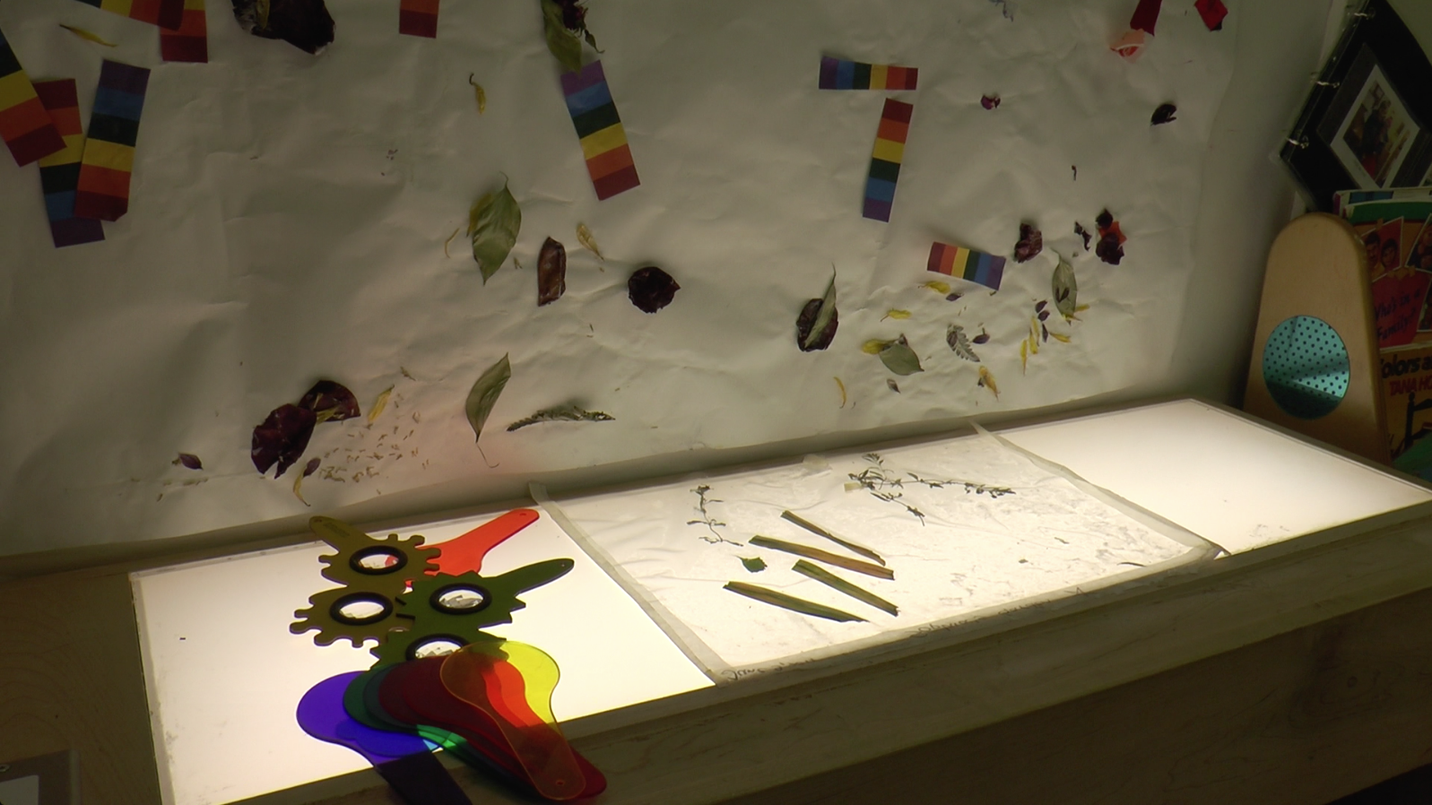
Group Discussion

Slide 10
Additional Information
All of the information came from a single family story. Many case studies simplify the experience of families, but we know that in reality, as human beings, the family is quite complex. In each of the scenarios above, the one piece of information can explain a situation. However, in fact, all of the information is interconnected.
Notes:
All of the information came from a single family story. Many case studies simplify the experience of families, but we know that in reality, as human beings, the family is quite complex. In each of the scenarios above, the one piece of information can explain a situation. However, in fact, all of the information is interconnected.

