Slide 1
CHRONIC DISEASES IN INDIGENOUS PEOPLE: HEALTH POLICIES & PROGRAM
CHANDRAKANT P. SHAH M.D., FRCPC, O.ONT.
PROFESSOR EMERITUS, DALLA LANA SCHOOL OF PUBLIC HEALTH
&
HONORARY STAFF PHYSICIAN, ANISHNAWABE HEALTH TOROTO
&
BOARD MEMBER, ANISHNAWBE HEALTH FOUNDATION
&
HONORARY STAFF, THE HOSPITAL FOR SICK CHILDREN
E-mail: c.shah@utoronto.ca

Slide 2
OBJECTIVES
1. BURDEN OF CHRONIC DISEASES & THEIR CONSEQUENCES
2. HEALTH POLICY & PROGRAM MUST CONSIDER IN DEALING WITH CHRONIC DISEASES IN INDIGENEOUS PEOPLE THE FOLLOWING ESSENTIAL FACTORS:
ROOT CAUSE ANALYSIS
ROLE OF SOCIAL DETERMINANTS OF HEALTH
INDIGENOUS CONCEPT OF HEALTH & HEALING

Slide 3
BURDEN OF CHRONIC DISEASES & THEIR CONSEQUENCES

Slide 4
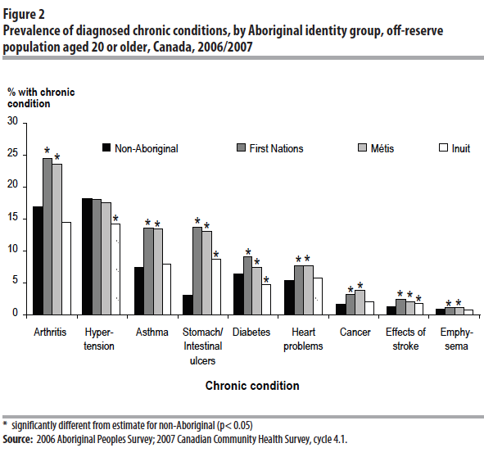

Slide 5
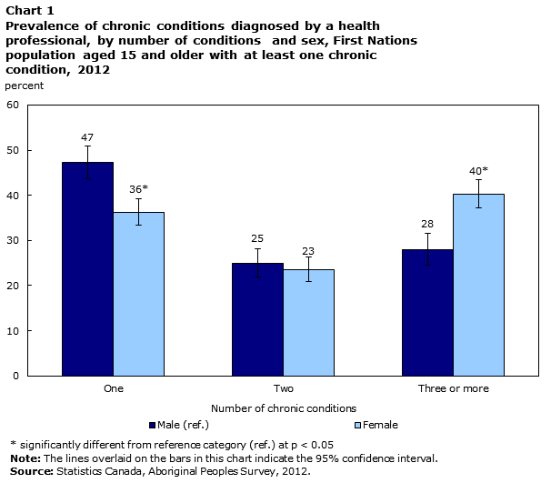

Slide 6
Example: Diabetes First Nations and Labrador Inuit to the Canadian Population, Age-gender-specific and age adjusted prevalence (%)
Gender
Age
Source: Young, T.K. et al. and FNIRHS Steering Committee and Canadian data from the NPHS, 1994-95.
Notes:
National Aboriginal Health Organization longitudinal study: 75% FN people over 35 yrs either have or will get diabetes

Slide 7
CHRONIC DISEASES LEADING TO DISABILITY

Slide 8
Source: Adapted from Statistics Canada, Custom Tabulation, Canadian Survey on Disability, 2012. Percentages are rounded to the nearest one decimal point. Reprinted from Ontario Human Rights Commission: By The Number A Statistical Profile of People with mental health and addiction disabilities in Ontario, October 2015.
E: use with caution

Slide 9
FACTORS INFLUENCING CHRONIC DISEASES IN INDIGENEOUS PEOPLE ROOT CAUSE ANALYSIS

Slide 10
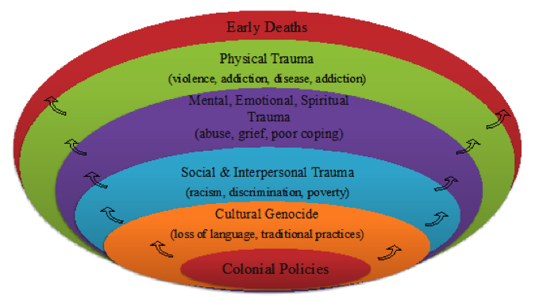
Root Cause Analysis: Delayed Tsunami Effect on
Health and Wellbeing of Aboriginal People due to
Colonization and Post Colonial Policies

Slide 11
From her Dene knowledge and experience, “everything that has to do with ill health as understood within Western medicine is a result of separation from land and land-based practices.”
LISA BOIVIN
“We are the land. The land is us”
CAN MED ASSOC JOURNAL, 2018; 190: E1085-6
Dene artist Alex Janvier

Slide 12
FACTORS INFLUENCING CHRONIC DISEASES IN INDIGENEOUS PEOPLE SOCIAL DETERMINANTS OF HEALTH

Slide 13
Social Determinants of Health
Social Determinants of Health | Aboriginal
Income and Social Status
Social Support Networks
Education
Employment/working conditions
Social Environment
Physical Environment
Personal Health Practices and Coping Skills
Healthy Child Development
Gender and Culture

Slide 14
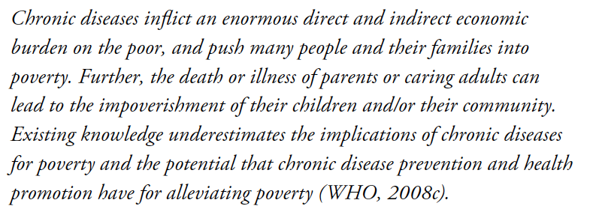
EFFECT OF POVERTY ON CHRONIC DISEASES

Slide 15
Social Determinants of Health
RACISM
IMPACT OF POST-COLONIAL POLICIES

Slide 16
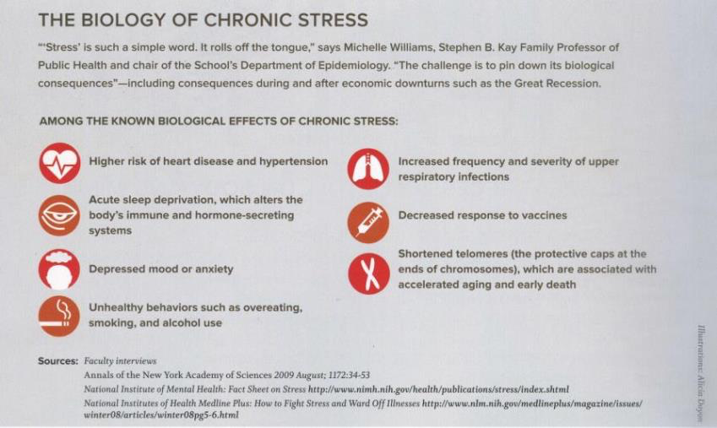
The Impact of Chronic Stress on the Health of Aboriginal People

Slide 17
FACTORS INFLUENCING CHRONIC DISEASES IN INDIGENEOUS PEOPLE CONCEPT OF HEALTH & HEALING

Slide 18
ABORIGINAL CONCEPT OF
HEALTH AND HEALING
Spiritual
Physical
Emotional
Mental
Emotional

Slide 19
Culturally Sensitive Programs Needed to Enhance Health
Ceremonies are about celebration, healing, and destroying negativity.
Spiritual Programs:
Shaking Tent
Full Moon Ceremony
Naming Ceremony
Clan Feasts
Pipe Ceremony
Vision Quests
Smudging
Traditional Teachings
Sweat Lodge
Cultural Workshops
Notes:
Students often ask about these ceremonies. You can access the details about these ceremonies at www.aht.ca

Slide 20
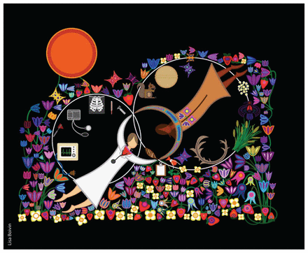
“Sharing Bioethics” shows dozens of land-based teachings. At first glance, the viewer can identify two intersecting circles of medicine. A circle surrounds a clinician in a white coat and bioscientific tools of medicine, such as a stethoscope and x-rays. In the Dene circle of medicine, plant medicine and Dene medicine stories are represented by a medicine bundle, strawberries and antlers. In the space where the circles intersect, the two healers also connect in a new space of relationship and possibility. In this new circle of medicine, neither knowledge or perspective is lost. ”Images Courtesy of Lisa Boivin” CAN MED ASSOC JOURNAL, 2018; 190: E1085-6.

Slide 21
REFERENCE
1. READING J. (2008): THE CRISIS OF CHRONIC DISEASES AMONG ABORIGINAL PEOPLES, A CHALLENGE FOR PUBLIC HEALTH, POPULATION HEALTH & SOCIAL POLICY. CENTER FOR ABORIGINAL RESEARCH, UNIV. OF VICTORIA
https://dspace.library.uvic.ca/bitstream/handle/1828/5380/Chronic-Disease-2009.pdf?sequence=1
2. NATIONAL COLLABORATING CENTER FOR ABORIGINAL HEALTH
https://www.nccah-ccnsa.ca/en/
THANK YOU
CONTACT: DR. C. P. SHAH
E-mail: c.shah@utoronto.ca

Slide 22
James Keller, Author, Clergyman

