Slide 1
CMHA

Slide 2
CMHA
The Canadian Mental Health Association
• CMHA National was incorporated in 1918, and will be celebrating 100 years of existence in 2018.
The only mental health and addictions organization of its kind, CMHA includes 10 Divisions across Canada.

Slide 3
CMHA Ontario
CMHA Ontario
• 30 branches across Ontario, providing service across the province.
• Approximately 3,900 CMHA staff across Ontario.

Slide 4
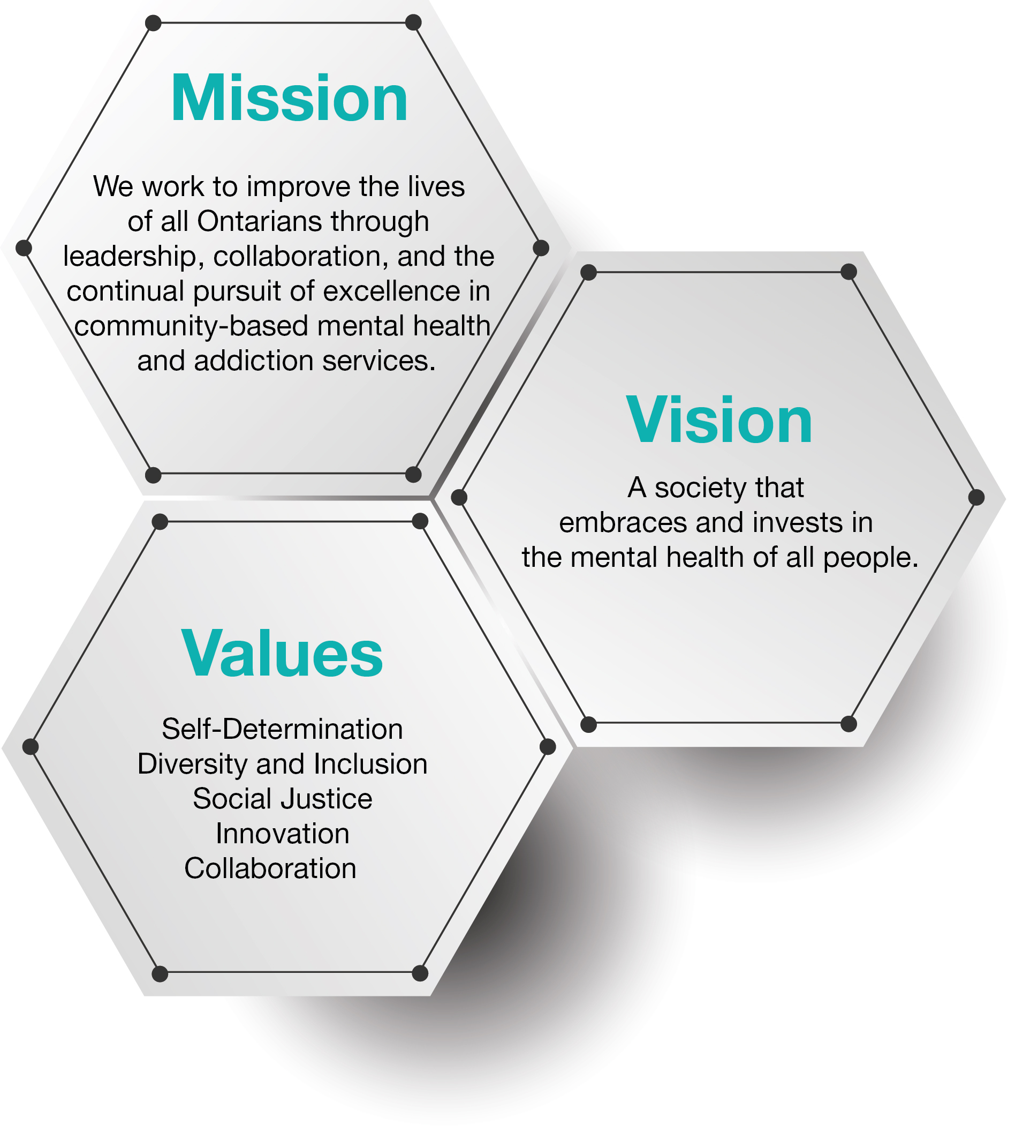
Mission Vision Values

Slide 5
CMHA Ontario
Our work helps to inform provincial policy, planning and service delivery to make mental health possible for all
All work is aligned with CMHA Ontario’s strategic directions
Provide reliable, current, accurate information and analysis of mental health and addictions issues to a range of stakeholders
Strategically advance systemic issues that impact on people with lived experience and the mental health system
Support, engage and champion community mental health and addictions

Slide 6
Advancing Public Policy
The public policy department informs provincial policy, planning and service delivery with a goal to make mental health possible for all.
The department focuses on the following key areas:
  Analyze: We provide stakeholders with reliable analysis of provincial mental health and addictions policy, system planning and service delivery.
  Mobilize: We increase action, collaborate, coordinate, and exchange knowledge between the multiple sectors and stakeholders that impact on provincial mental health and addictions policy, planning and service delivery.
  Educate: We increase awareness of key sector evidence that impacts on mental health and addictions policy, planning and service.
  Advocate: We work to strategically advance systemic issues that impact people with lived experience of mental illnesses and addictions.
  Champion: We engage and champion the work of the community mental health and addictions sector and CMHA branches.

Slide 7
Enhanced investment in mental health and addictions makes sense when you consider that in Ontario the burden of mental illness is 1.5 times that of all cancers combined and more than seven times of all infectious diseases.[i]
[1] Ratnasingham S, Cairney J, Rehm J, Manson H, Kurdyak PA. (2012) Opening Eyes, Opening Minds: The Ontario Burden of Mental Illness and Addictions Report https://www.ices.on.ca/Publications/Atlases-and-Reports/2012/Opening-Eyes-Opening-Minds

Slide 8
Advancing Public Policy
Health Systems Transformation
Addictions & Complex Care
Equity & Social Inclusion
Criminal Justice
Health Promotion Across the Lifespan
Housing, Employment & Social Determinants of Health

Slide 9

Advancing Public Policy
https://ontario.cmha.ca/documents/reducing-harms-recognizing-and-responding-to-opioid-overdoses-in-your-organization/

Slide 10
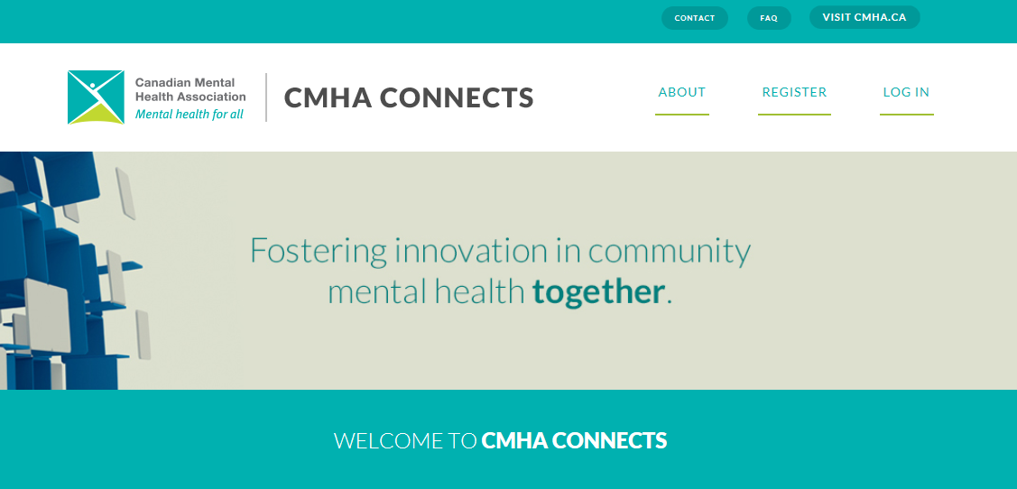
Communities of Practice
CMHA Ontario actively connects staff across CMHA branches through CMHA Connects, conferences and other media:
ED Network (meets four times a year)
ED Listserv
Human Resources Community of Practice
Executive Assistant Community of Practice
CMHA Ontario Governors’ Portal
Clinical Leads Symposium

Slide 11



Conferences

Slide 12






Provincial Programs
E-QIP

Slide 13
A social enterprise of CMHA Ontario
Capacity-building workshops to train employees on awareness, intervention, and prevention skills
Available and expanding through CMHA Branches and Divisions across Canada, in English and French
Part of the CMHA Nation-wide Workplace Mental Health Initiative

Slide 14
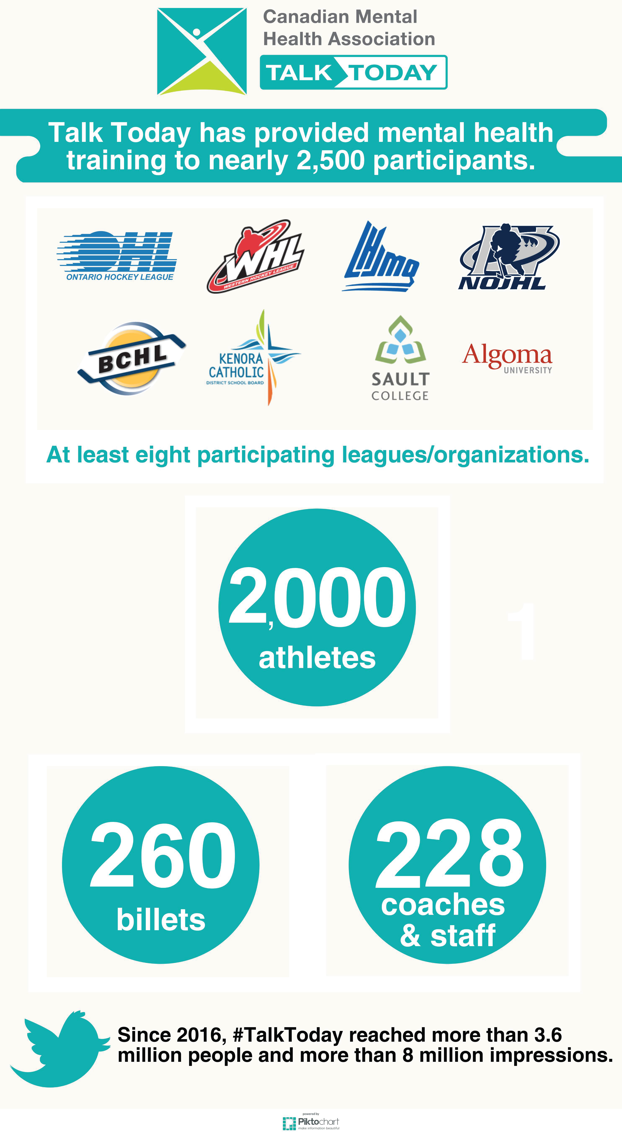

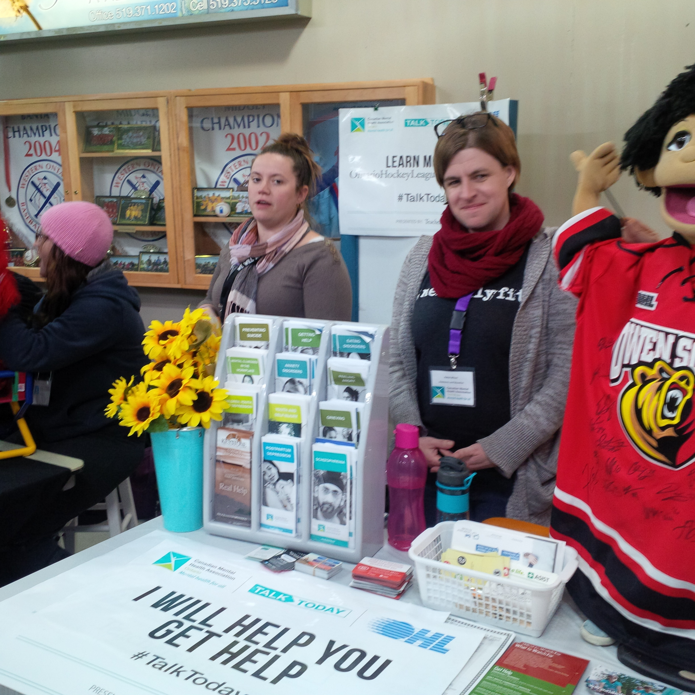


Slide 15
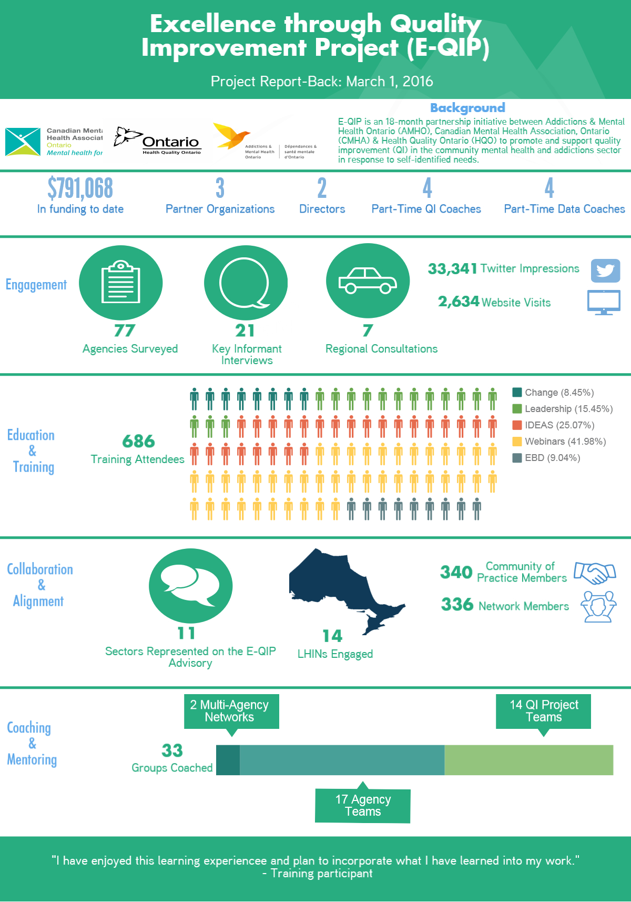

Slide 16
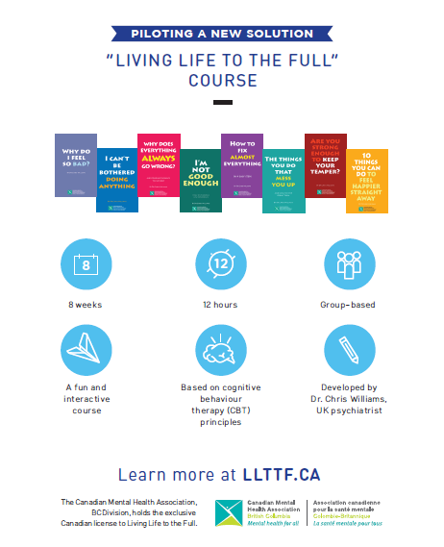

Slide 17
The program is based on a five areas approach which addresses:
  Life situations, problems, and difficulties
  Symptoms in the body
  Unhelpful thinking
  Altered feelings (moods or emotions)
  Altered behavior and reduced activities
This free self-help program offers:
Living Life to the Full DVD:
This resource provides you with practical tips on how to recognize and deal with depressive symptoms. The DVD is available in English, Mandarin and Cantonese.
Telephone coaching and workbooks:
Trained Bounce Back coaches assist in the teaching of problem-solving and other skills to overcome difficulties. In addition, the role of the coach is to keep you motivated, to answer your questions, and to monitor how you’re doing. Your coach will send you workbooks – which are yours to keep – at the right stages to help you complete this self-help program step by step. Because Bounce Back coaches are not mental health specialists, they don’t provide counselling. Coaches are trained in the delivery of a specific program known to be effective in relieving mild to moderate depression (with or without anxiety) and they are overseen by psychologists.

Slide 18
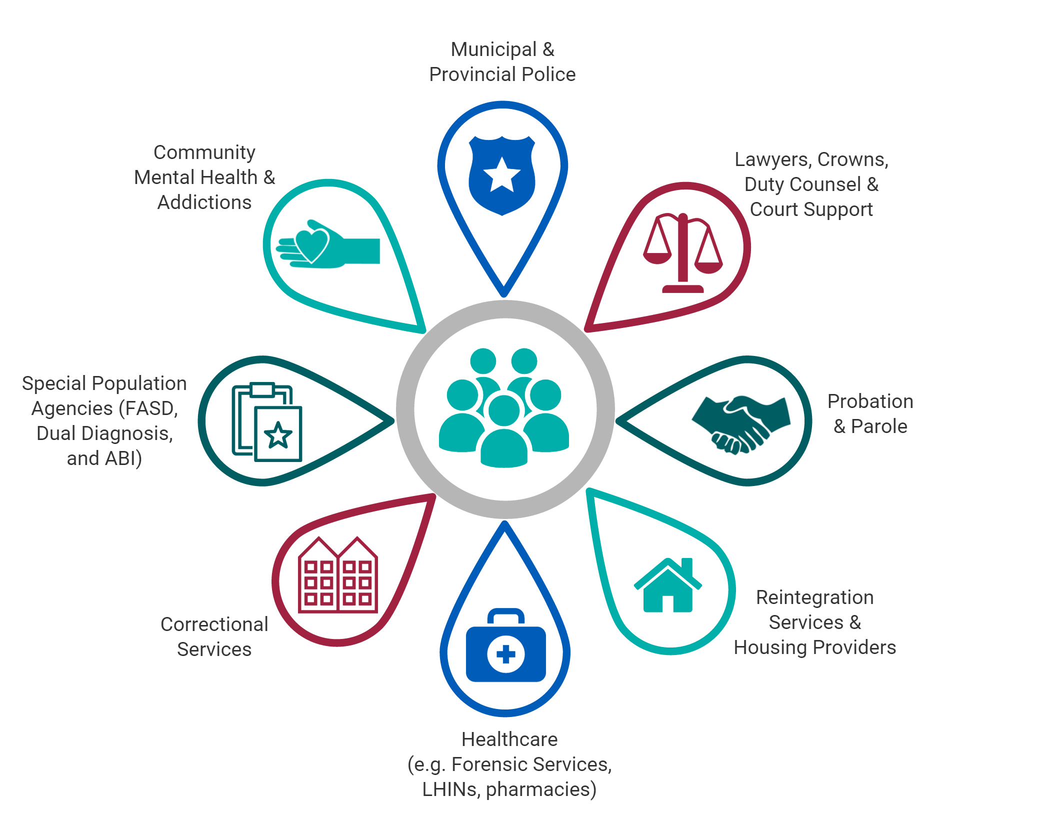
The Human Services and Justice Coordinating Committees (HSJCCs) were established in response to a recognized need to coordinate resources and services, and plan more effectively for people who are in conflict with the law. Priority consideration is for people with a serious mental illness, developmental disability, acquired brain injury, drug and alcohol addiction, and/or fetal alcohol syndrome. The committees were generated as a cooperative effort between the Ministries of the Attorney General, Community and Social Services, Children and Youth Services, Health and Long-Term Care, and Community Safety and Correctional Services.
The two primary areas of emphasis for the committees are:
To provide a planning table to bring together service providers to find solutions to the problem of the criminalization of people with the defined unique needs, and;
To develop a model of shared responsibility and accountability in dealing with this group of individuals at points of intersection with the justice system.
Each HSJCC is a voluntary collaboration between health and social service organizations, community mental health and addictions organizations and partners from the justice sector including crown attorneys, judges, police services and correctional service providers. The HSJCC Network consists of 42 Local HSJCCs, 14 Regional HSJCCs, and a Provincial HSJCC.

Slide 19
The Centre for Innovation on Campus Mental Health (CICMH) is a partnership project involving Colleges Ontario, the Council of Ontario Universities, the Ontario Undergraduate Student Alliance, the College Student Alliance and the Canadian Mental Health Association, Ontario Division.
Our Mission
To help Ontario’s colleges and universities enhance capacity to support student mental health and well-being
Our Vision
To optimize mental health and well-being for Ontario’s postsecondary students.
What We Do:
CICMH is working with its partners and stakeholders to:
Facilitate a Community of Practice:
CICMH has created a campus mental health community of practice which connects a broad cross-section of stakeholders in Ontario, including student services, counselling, accessibility, health, faculty, administration, student leaders and community partners. Members of the community of practice learn from each other, collaborate, share knowledge and experiences, best and promising practices; and jointly problem-solve to address gaps in the field. An online portal helps support this community practice by providing members with a virtual space to continue their sharing, learning and collaboration.
Coordinate access to expertise:
To help enhance campus service providers’ capacity to meet the needs of students with complex mental health and addiction concerns, CICMH is identifying models and networks that would facilitate access to community-based expertise and professional development.
Foster and Support Innovation:
CICMH is working with campus mental health stakeholders to identify innovative ideas and approaches that address gaps and enhance practice in student mental health services and programs (i.e., prevention, promotion and treatment). CICMH will help support and leverage promising programs and services that could have a system-wide impact.

Slide 20
Thank you!

