Slide 1
\
Women’s Health in Women’s Hands CHC
I
3rd Annual Health Policy Conference – Ryerson University
Notisha Massaquoi
Executive Director
September 19, 2018

Slide 2
What I know for Sure
Health interventions, government policy and financial resources should be redirected and attention focused on the segments of our population with the highest level of health risk and health disparities.

Slide 3
What I know for Sure
Health services, health service providers and health policies that hold themselves accountable to Racialized Communities and our wellbeing will be the most successful!

Slide 4
Our Data Our Story
97% of our clients are racialized ( 44% Caribbean, 15% African, 16% Latin American, 7% South Asian)
83% Female
2% Male
15% Transgender
66.7% under 40 (31=ave)
51% Post Secondary
32% unemployed
63% household income less than $14,999
15% support 5 or more
78% Born outside Canada
57% in Canada less than 10 years
10.5 visits per year
45% Chronic Illness
46% undocumented without OHIP
78% addressing violence
67% addressing sexual violence

Slide 5
REASONS FOR VISIT
1
Diabetes
Food Insecurity
2017
3200 Clients
DEPRESSION
Anxiety
Periodic Health Exam
Reproductive Health
Hypertension
Immigration
Prenatal care
HIV/AIDS

Slide 6
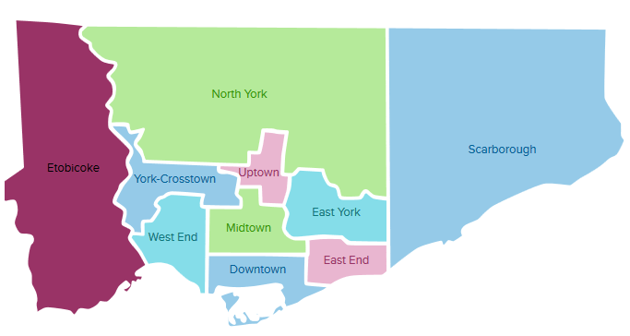
Client Mapping
2016 WHIWH Client Survey
1.54%
York Region 1.54%
1.15%
Peel Region
4.61%
14.23%
14.23%
7.69%
Hamilton – Wentworth Region 0.77%
2.69%
Durham 3.84%
8.84%
Niagara Region 0.38%
21.15%
4.61%
12.69%
Notes:
3) Geographic Location

Slide 7
WHIWH Top 5% Service Users
Category | Description
Encounters/Visits Income Age | 30-66 (Ave= 39) 62%< $15,000 18-55 (Ave= 32)
# of WHIWH providers # of Meds | 1-6 (Ave=4.4) 3-24 (Ave =10)
Major Dx | HIV 15% Diabetes 25% Mental Health 75% -Anxiety 45% -Depression 45% -Bipolar 15%

Slide 8
Race-Poverty-Depression

Slide 9
Prevention Programs

Slide 10
Prevention Programs

Slide 11
Prevention Programs
 | WHIWH | ONTARIO CHCs
# of Clients included | 896 | 217298
# of Clients not included | 636 | 28736
Age 0-4 (%) | 2.8 | 6.5
Age 5-9 (%) | 0.0 | 5.3
Age 10-45 (%) | 65.1 | 46.3
Age 46-64 (%) | 27.8 | 26.5
Age 65-89 (%) | 4.4 | 14.8
Age 90-104 | 0.0 | 0.6
Income Quintile 1 (%) | 44.4 | 33.4
Income Quintile 2 (%) | 23.3 | 21.6
Income Quintile 3 (%) | 15.2 | 17.5
Income Quintile 4 (%) | 7.7 | 15.1
Income Quintile 5 (%) | 8.4 | 12.1
% Male | 2.0 | 42.1
% Newcomer | 48.5 | 14.0

Slide 12
Prevention Programs
Cancer Screening | ICES With OHIP | WHIWH No OHIP | Ontario CHC’s
Cervical | 66.8% | 78.33% | 66.2%
Breast | 72.2% | 44.00% | 62.7%
Colon | 67.8% | 31.22% | 64.9%

Slide 13
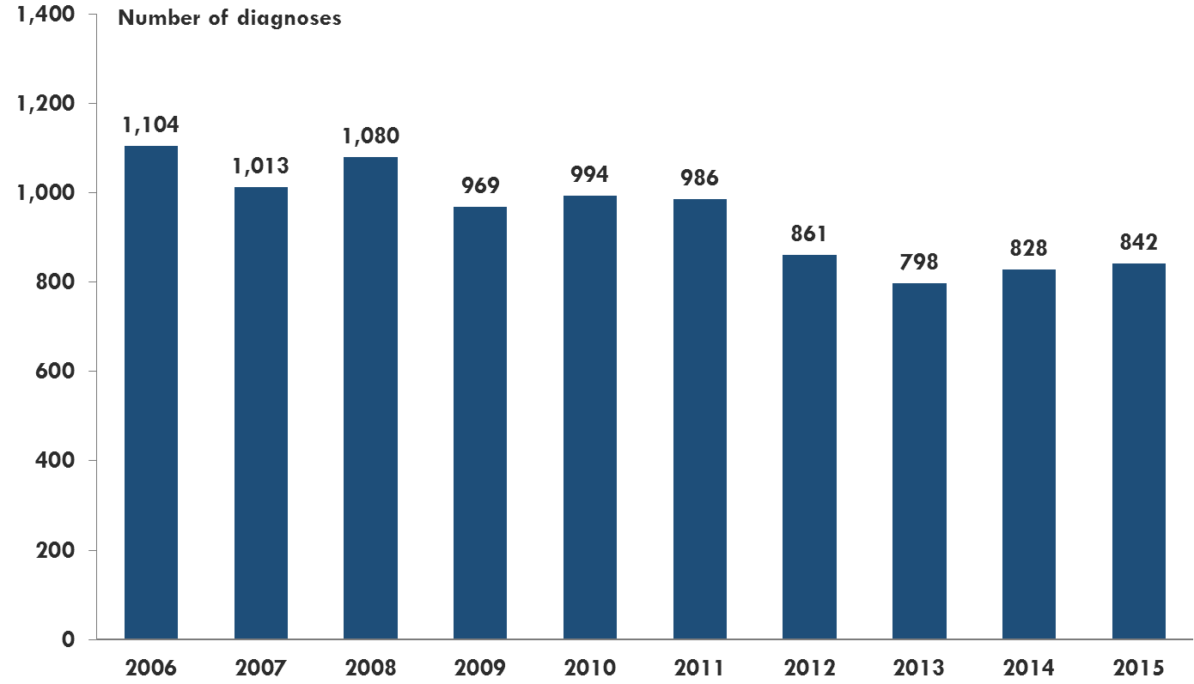
Health Disparities as Directives New HIV diagnoses, total, Ontario, 2006-2015
Notes:
Key points
The number of new HIV diagnoses has generally decreased over the past decade.
There has been a slight increasing trend since 2013. This increase does not necessarily mean that HIV infections are increasing, and may partly be due to increased HIV testing during this time.
There were 842 new HIV diagnoses in 2015, which was slightly higher than the 828 diagnoses in 2014. The number of diagnoses in 2015 was still lower than most years over the past decade.

Slide 14
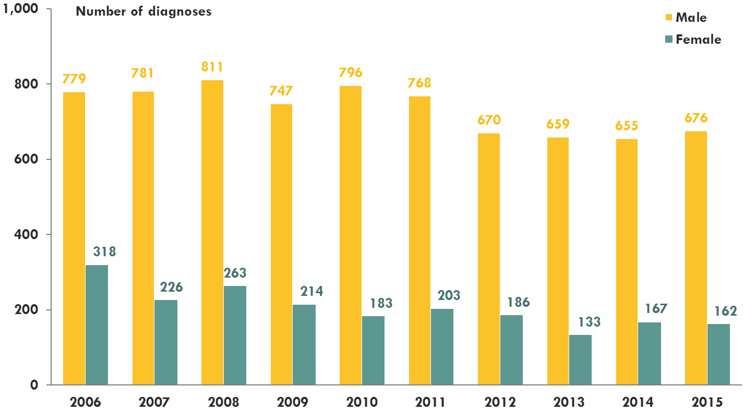
New HIV diagnoses by sex, Ontario, 2006-2015
Notes:
Key Points
There was a slight increase in male diagnoses from 2014 (655) to 2015.
The percent female diagnoses have generally decreased over the past decade and was 19% in 2015.

Slide 15
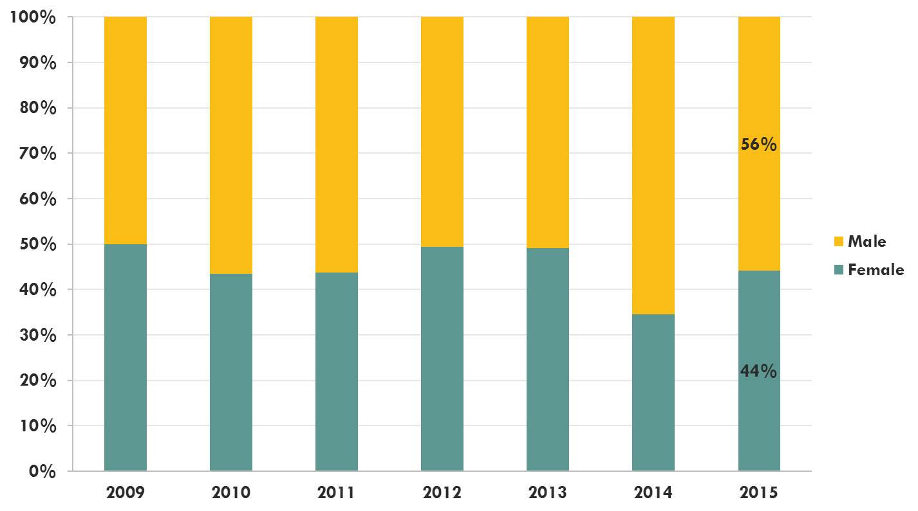
Without disaggregated data we would have missed the enormous difference in prevalence rates for Black Women Percent of HIV diagnoses by sex, ACB, Ontario, 2009-2015
Notes:
Key Points
In 2015, the majority (56%) of ACB diagnoses were male.
The percent female diagnoses has slightly decreased over time.

Slide 16
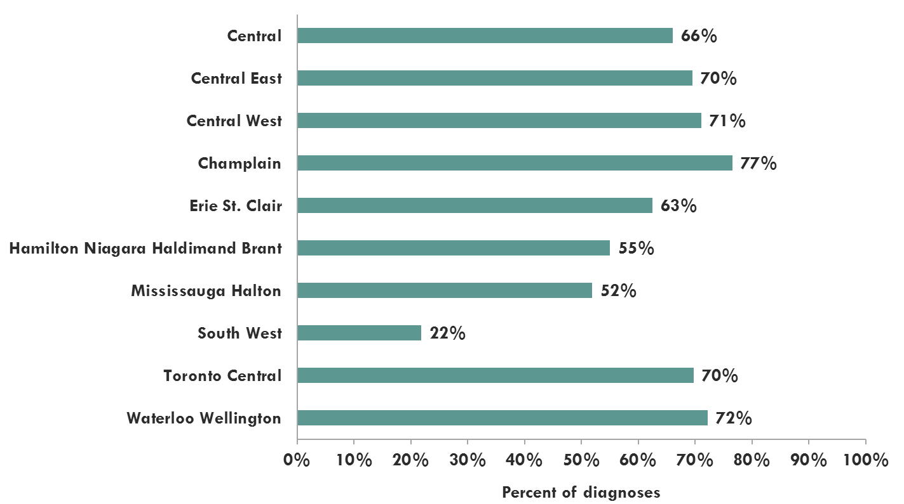
Percent of female HIV diagnoses identified as ACB by LHIN (select), Ontario, 2011-2015
Notes:
Key points
The percent of female HIV diagnoses identified as ACB varied from 77% (Champlain) to 22% (South West).

Slide 17
What I know for Sure
Health interventions, government policy and financial resources should be redirected and attention focused on the segments of our population with the highest level of health risk and health disparities.

Slide 18
What I know for Sure
Health services, health service providers and health policies that hold themselves accountable to Racialized Communities and our wellbeing will be the most successful!

Slide 19
\
Thank you for your energy !
www.whiwh.com

