Slide 1
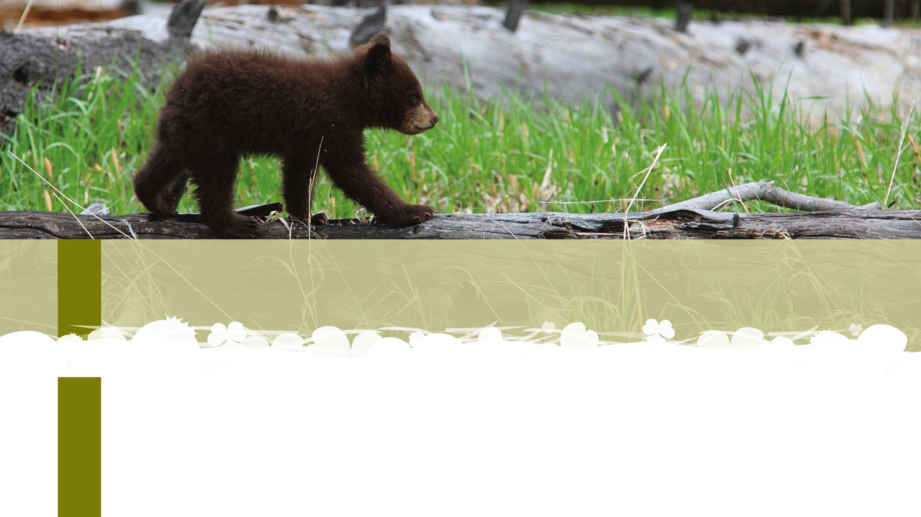
Considerations for the Transformation and Change of Policy
Ryerson Health Policy, Programming and Practice Event
Toronto, Ontario
September 19, 2018
Notes:
Margo Greenwood nit see git soon
I am Neheyoh from Treaty 6 territory in Alberta
I begin by acknowledging the ancestors and unceded territories of the Missasaugua peoples of New Credit First Nation. I thank them for allowing me to be here to speak about our children, families and communities.

Slide 2

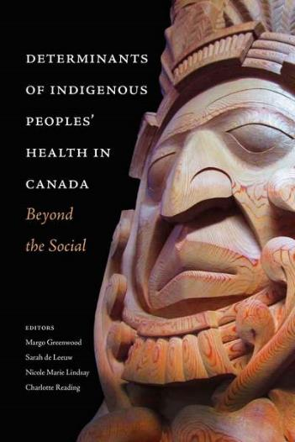

Purpose
The purpose of this presentation is to contemplate considerations necessary to the transformation and change of health policies that impact Indigenous peoples.
Notes:
I was invited to speak about health policy transformation from and Indigenous perspective.

Slide 3
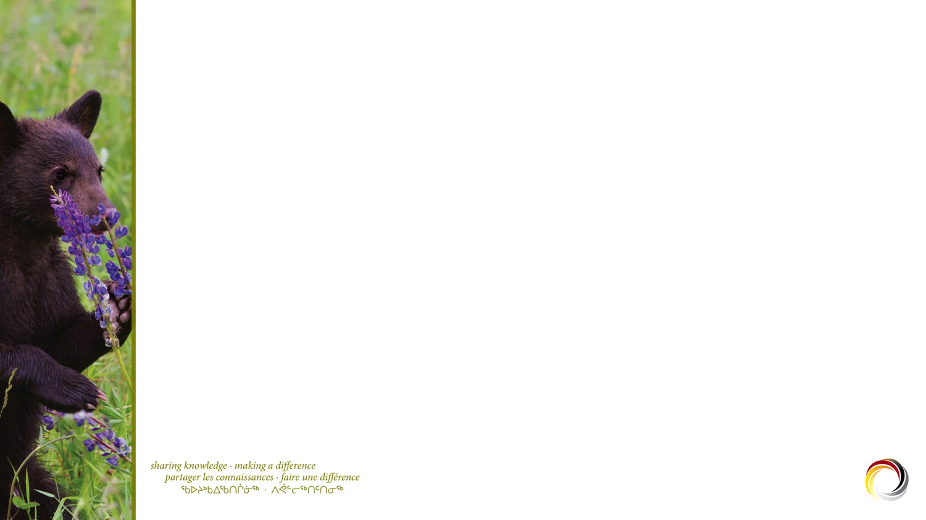

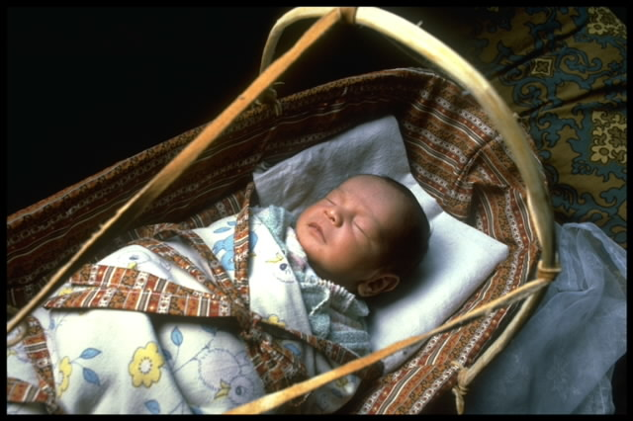
Slide Title
Indigenous worldviews
Slide text
  More text
    Other text
      Some more text
Leroy Little Bear writes that different peoples see and interpret the world in different ways. These unique ways are evident in different world views and cultures.
Indigenous philosophies are underlain by a world view of interrelationships among the spiritual, the natural and the self where the land is sacred, where time is not linear but cyclical and where there are multiple truths.
Indigenous societies act in a state of relatedness; identity comes from the connections of the collective.
Notes:
Indigenous philosophies are underlied by a world view of interrelationships among the spiritual, the natural and the self which forms the foundation or beginnings of Indigenous ways of knowing and being. All things are embued with spirit and we are in relationship with all that surrounds us
Greg Cajete describes Indigenous peoples’ relationships with them as embodying a “theology of place” a reflection and sacred orientation to place and space. He explains that “we come to a spiritual understanding through “the intimate relationship peoples establish with place and the environment and with all things that make or give them life.”
“The land has become an extension of Indian thought and being because, as one Peublo Elder put it, it is this place that holds our memories and the bones of our people … this is the place that made us.”
Tell understanding of Treaty

Slide 4
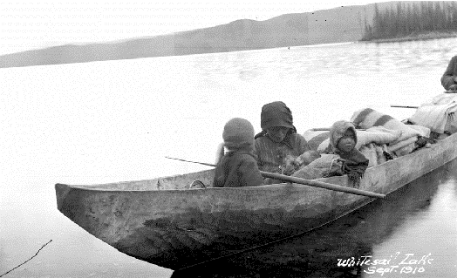
Shifting ground …
Royal Commission on Aboriginal Peoples (1996)
Truth and Reconciliation Commission (2015)
Newly elected Liberal government (2015)
United Nations Declaration on the Rights of Indigenous Peoples (2007, 2016)
Truth and Reconciliation Commission Report (2015)
Human Rights Tribunal
Sixties Scoop
Child Welfare Reform
Indian Hospitals (2018)
Notes:
Royal Commission on Aboriginal Peoples Report (1996) - took a comprehensive look at all aspects of Indigenous peoples lives. It envisioned a “circle of well-being” in which self-government, economic self-reliance partnerships of mutual respect with and Canada and healing would feed into one another working toward elimination of persistent inequities.
Truth and Reconciliation Commission’s Final Report December 2015 - Mandate was to inform Canadians about the Indian Residential Schools. Offers us 94 ‘calls to action’ to redress the legacy of residential schools and to advance the process of Canadian reconciliation
Newly elected Liberal Government 2015 – in their “Real Change” platform committed to “a renewed nation-to-nation relationship with Indigenous peoples based on recognition, rights, respect, co-operation and partnership.” Prime Minister Trudeau states the single most important relationship to address in Canada is the relationship with Indigenous peoples.
United Declaration on the Rights of Indigenous Peoples – Adopted in 2007, Canada did not fully endorse the Declaration until 2016.
Human Rights Tribunal – found that the federal government discriminates against First Nations children on reserves by failing to provide the same level of child welfare services that exist else where.
The sixties scoop is just starting to be litigated. (Class action launched around sixties scoop)
Child Welfare - More children are apprehended today than there were in the height of the residential school era

Slide 5

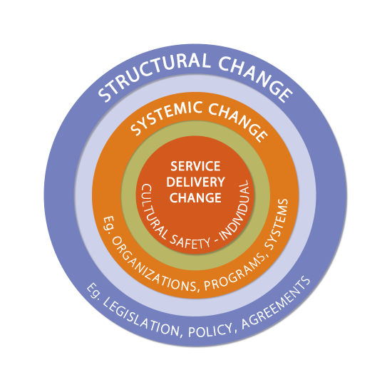
Getting to Change
  PLACES OF CHANGE
  Structural Change: legislation, policy, agreements …
  Systemic Change:
  organizations, programs, systems …
  Service Delivery Change: individual relationships
Notes:
Derived from Social Determinants of Health models that seek to address health inequities experienced by Indigenous peoples. This model seeks to make explicit focus areas for change.
Structural Change
Governments agreeing to a new relationship (Frist Nations have decision making power in matters concerning their health)
Formation of the FNHA
Delivery of previously federal government services on reserve by First Nations
Systemic Change
Regional Health Authority Agreements with FNHA
Creation of a Northern First Nations Health and Wellness Plan
Creation of Specific Working Groups – e.g. Population and Public Health (decisions and activities are undertaken in partnership)
Creation of a VP of Aboriginal Health
Senior leadership commits to realization of First Nations Health and Wellness Plan
Signing of a Declaration on Cultural Safety and Humility
Individual Change
Promoting being the “very best partner we can be”
- engaging internally and externally 8200 employees, relationships with Indigneous peoples – ensuring voice
- resource development
- promoting training and education ie cross cultural education
- building on local structures – AHICs
Creating system changes:
Signing Northern Partnership Agreement
Actively participating in the Northern First Nations Health Partnership Committee
Ensuring senior leadership have a commitment to realizing the Northern First Nations Health and Wellness Plan (NFNHWP) in their annual work plan
Ensuring all new senior hires are committed to the NFNHWP
Co-creating governance documents
reinvigorating existing structures – Aboriginal Health Improvement Committees
shifting the focus of the Aboriginal health team to knowledge translation

Slide 6
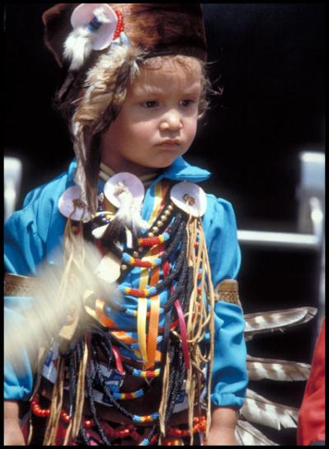
Indigenous Early Learning and Child Care: a High Level Policy Framework
Vision
Envisions First Nations, Inuit and Metis children and families as happy and safe, imbued with a strong cultural identity. It sees children and families supported by a comprehensive and coordinated system of ELCC polices, programs and services that are led by Indigenous peoples, rooted in Indigenous knowledges, cultures and languages, and supported by strong partnerships of holistic, accessible and flexible programming that is inclusive of the needs and aspirations of Indigenous children and families.
Notes:
Supports Indigenous children and families
Broad principles compatible with those of child and family services

Slide 7
Slide Title
Indigenous Early Learning and Child Care Principles
Slide text
  More text
    Other text
      Some more text
Indigenous Knowledges, Languages and Cultures
First Nations, Inuit and Metis Determination
Quality Programs and Services
Child and Family Centred
Inclusive
Flexible and Adaptable
Accessible
Transparent and Accountable
Respect, Collaboration and Partnerships

Slide 8
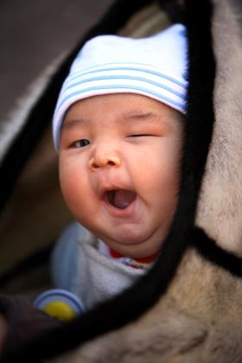
Operationalizing the IELCC
Structural and Systemic Enablers
Principles and strategic actions that focus on:
First Nations legislation including standards and regulations
First Nations governance structures anchored in Indigenous ways of knowing and being
Holistic, transparent funding approaches
Partnerships and linkages across sectors and disciplines, e.g. connections to health, education, economic development housing
Reciprocal accountability to individuals, community First Nations governments and funders
Quality Programs and Practices
Structural and systemic enablers result in:
Programs and practices anchored in FN ways of knowing and being
Programs and services that are inclusive, accessible, and flexible

Slide 9
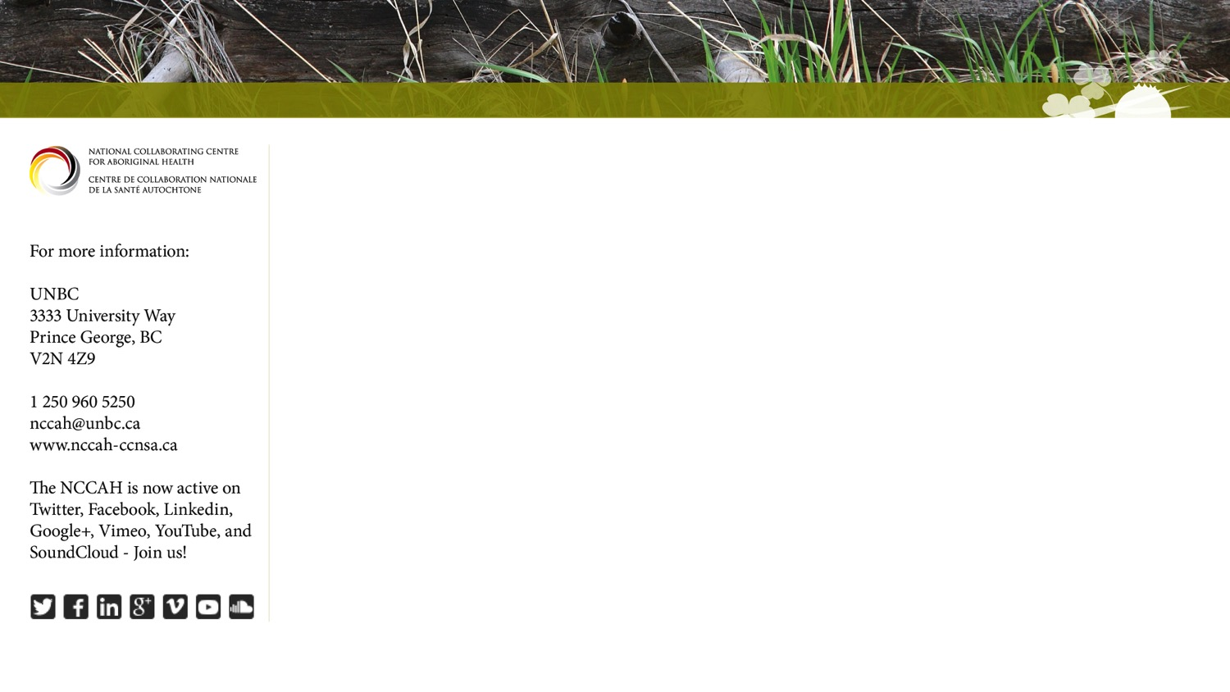
Thank you

Slide 10

Social Determinants of Health Approach
Social determinants of health represents a change in how health was viewed shifting from an individual medical model to a more contextualized way of thinking about peoples’ health
As long as there has been colonial contact the state has intervened in Indigenous families viewing them individually through a similar disease-like model where the solution has been to reach in and remove children from their families and communities
SDOH demands an understanding of the contextual factors that surround children and families and promotes a cultural model of child welfare which is understood at the community and nation levels

Slide 11
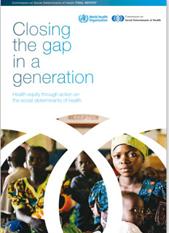
Slide Title
Social Determinants of Health
Slide text
  More text
    Other text
      Some more text
World Health Organization (WHO) hosted 1st International Conference on Health Promotion in November, 1986
Resulted in the Ottawa Charter on Health Promotion which stated that public health research and action should: 1) target the ‘upstream factors’ like healthy environments and social contexts and 2) focus on populations vs individual interventions based on 9 specific contextual factors
In 2009 the WHO released, Closing the Gap in a Generation a global report that focuses on addressing inequities by examining the contextual realities of individuals lives.
Notes:
Review the slide

Slide 12
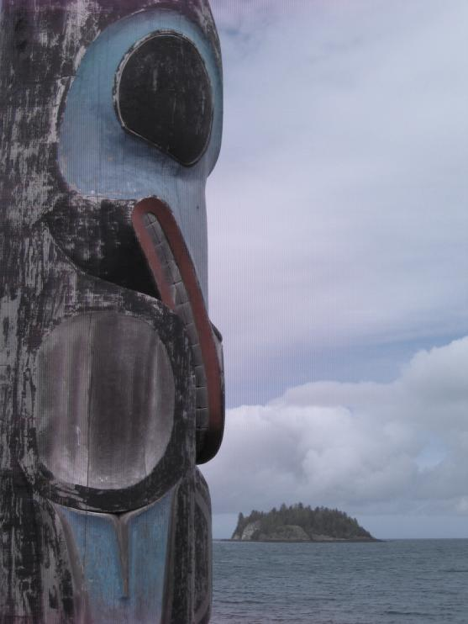
Social Determinants of Health Approach (cont’d)
Health from a social determinants perspective moves a way from looking at single factors, e.g. disease, smoking behaviour or diet, to looking at the social contexts in which a person works, plays, loves, and experiences life and to the social factors which impact the person’s life like: income and employment, education, early childhood development and housing
Notes:
Social determinants (and others) are shaped by the distribution of money, power, and resources at the global, national and local levels and their relationship to health; for example, “the lower an individual’s socioeconomic status, the worse their health”.
Makes the point that change in social determinants of health impacting peoples’ lives requires states and/or governments to
transform legislation and policy. These changes then enable good practice

Slide 13
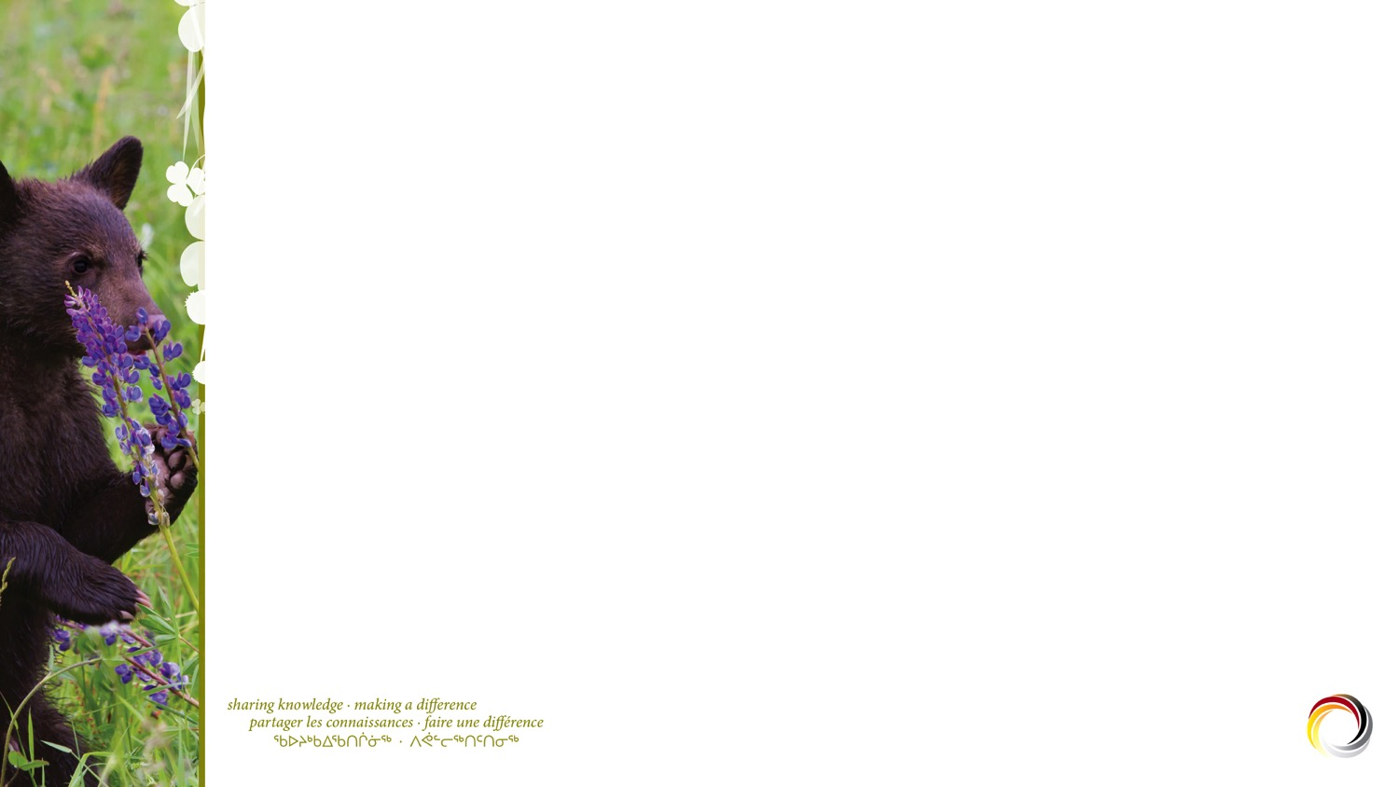
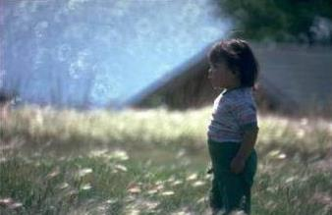
Social Determinants List
early life or early childhood
education
  employment and working conditions
  gender
  food security
health care services
  housing
  income and its distribution
social safety net
  social exclusion
  unemployment and employment security (Public Health Agency of Canada
)

Slide 14
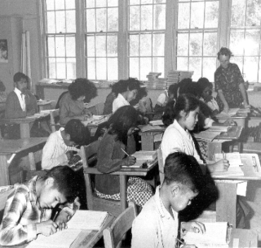
Slide Title
Unique Determinants of Indigenous Peoples’ Health
Slide text
  More text
    Other text
      Some more text
Colonization
Residential schools
Colonialism and multiple forms of discrimination e.g. racism including :
Micro-aggressions
Self-determination
Language and culture
Indigeneity
Geography
Spirituality
.
Notes:
Social determinants (and others) are shaped by the distribution of money, power, and resources at the global, national and local levels and their relationship to health; for example, “the lower an individual’s socioeconomic status, the worse their health”.
Makes the point that change in social determinants of health impacting peoples’ lives requires states and/or governments to
transform legislation and policy.

Slide 15
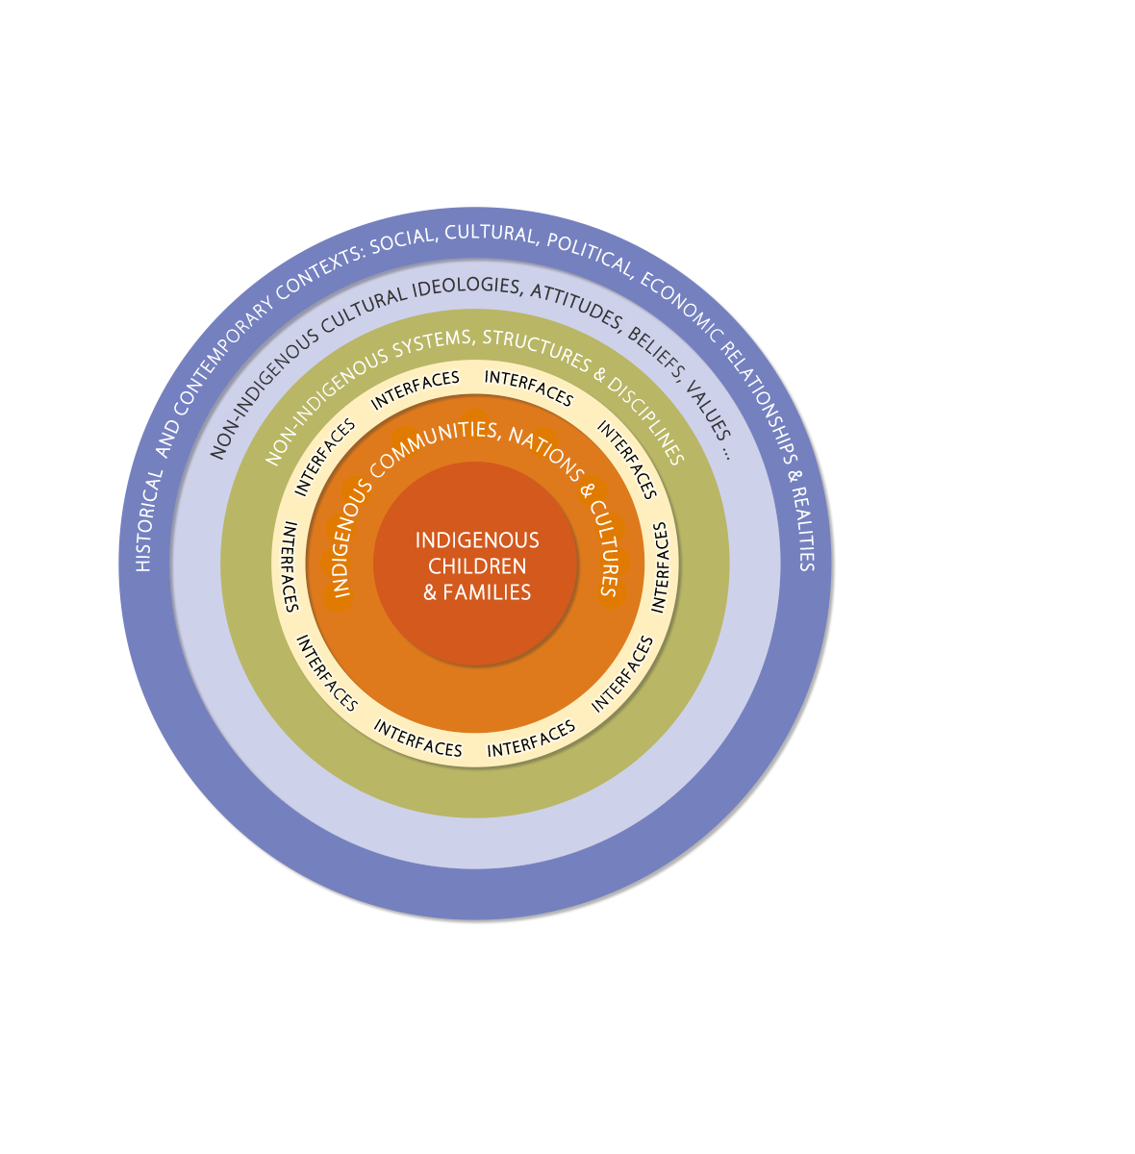
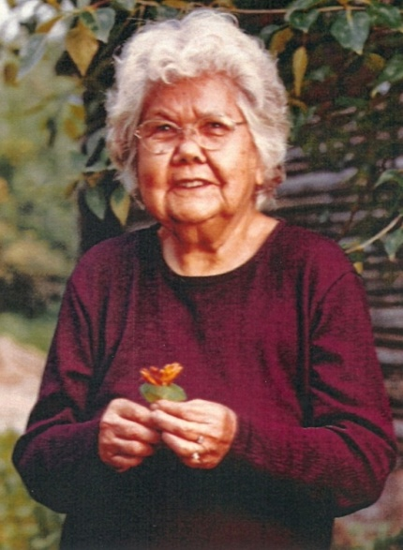
A framework for understanding the determinants of health and Indigenous People: Interfaces
Notes:
This model considers the relationship between cultures -- power differences.
These are fundamental considerations when thinking about the health and well being of Indigenous peoples especially when we think about the relationship between the social environment and chronic diseases such as diabetes, cardiovascular disease, chronic respiratory disease and so on and we are searching for solutions.

Slide 16
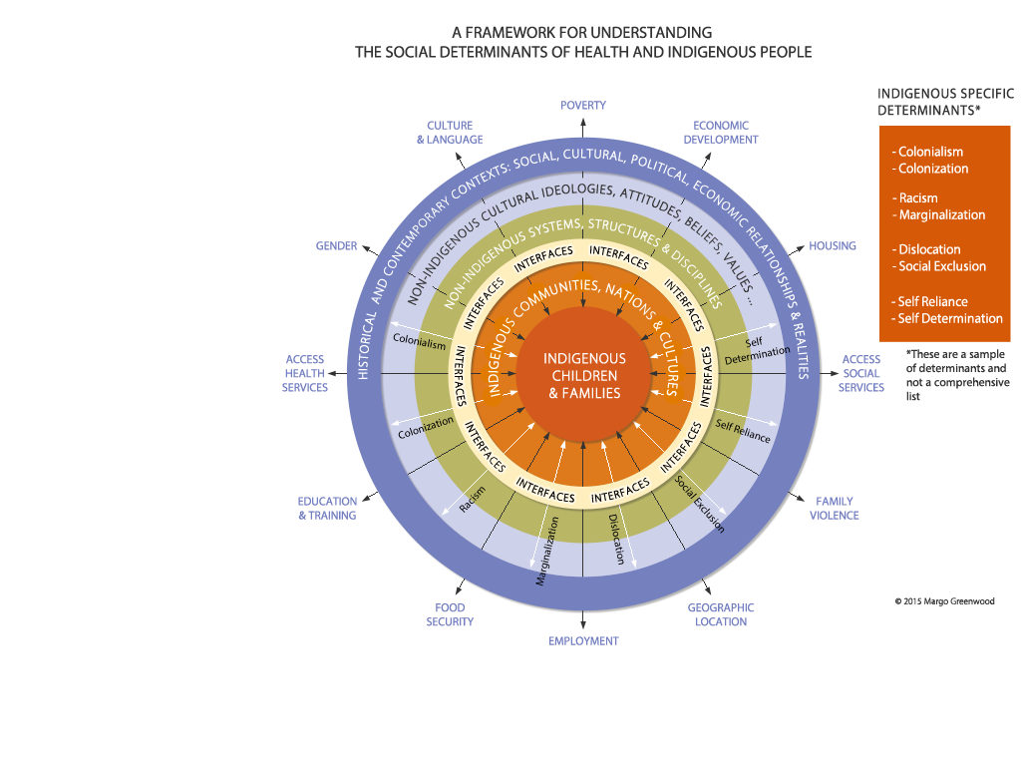
Slide Title
  Determinants of Health
  early life
  education
  employment and
  working conditions
  gender
  food security
  health care services
  housing
  income and its distribution
  social safety net
  social exclusion
  unemployment and
  employment security
Slide text
  More text
    Other text
      Some more text
Notes:
This model offers a depiction of indigenous and non-indigenous relationships and realities. It places Indigenous children and families in the centre. This inner centre is embedded in Indigenous communities and nations with distinct cultures with their ideologies, political, social and economic contexts. They also have unique knowledge systems. It is these distinct ways of knowing and being in the world that can come into to discord with other systems of knowledge and their ways of knowing and being in the world.
Next to this interface circle are Non-Indigenous structures, systems, disciplines, sectors and so on. This circle is embedded in Non-indigenous cultural ideologies, attitudes, beliefs, values etc. These circle representations are situated in historical and contemporary contexts of relationship and social cultural political economic and ideological realities.
The determinants of health impacting individuals and communities are the black arrows that run through and across the circles each influenced by the realities in which they originate and with which they interface. They may not stretch right across all circles but may originate in any one of them. The white arrows are Indigenous specific determinants and less flexible that others in that they are distinctly relational.
The purpose of this model is meant to capture the relational aspect of a colonial reality as well as providing opportunities for exploring the interface of diverse realities and systems of knowledge. In many cases this is where are partnerships are situated.

Slide 17
Slide Title
Making it real …
Slide text
  More text
    Other text
      Some more text
Structural and system changes enables transformation at the operational level
Individual change happens at the service delivery level, in individual interactions
Models help us to understand the complexity of the realities we live in
Provide a context to health realities
Select one topic or challenge to address
Engage community in identifying and addressing challenges
Multiple stakeholders play a role in health and well-being
Need to cross disciplines, sectors and break down
traditional silos
Notes:
We live in complex times
We all want good things for our children
Indigenous children learn to walk in multiple worlds
Identity formation paramount learning for Indigenous children
Attachment to people and to the land, language and culture are critical to children’s development, well being and resilience (First Nations Early Childhood Education Chapter, FNIGC, 2016)
Relationships with family and community are the vehicle through which children learn their social values, a sense of identity, and cultural continuity
Children’s homes are a place of learning and intervention
Federal provincial actions (e.g. ELCC Agreements) affect Indigenous peoples
Leads to self-determination and self-sufficiency (healthy families and communities
Programs separated by disciplines, theoretical underpinnings, formal and informal settings, training

Slide 18
Determinants of Health and Child and Family Well-being

Slide 19
Structural Change - Self-determination, legislation and governance….
Development and implementation of Indigenous specific standards
Monitored by First Nations
Establishment of First Nations governance structures

Slide 20
Slide Title
Examples of Administrative Indicators
First Nations communities have access to culturally-appropriate prevention and early intervention services
- Number of First Nations families on reserve who have been assisted through culturally appropriate prevention activities
Number of First Nations communities that are implementing their own Family and Community Well-Being and or Jurisdiction Initiatives
Percent of cases of First nations children at risk that are closed without being take into care
First Nations service providers have adequate and predictable resources that allow for the development and delivery of culturally based child welfare standards and services including prevention services
Slide text
  More text
    Other text
      Some more text
Individual and Family Change:
Indicators of Child and Family Well-being

Slide 21
Slide Title
Examples of Administrative Indicators
Continuity of family community and cultural connections is preserved for First Nations children in care
The safety and well-being of First Nations children are improved
First Nations children in care achieve permanence and stability
The rate of First nations children going into care is decreased
The rate of Adverse Childhood Experiences among First Nations children and youth is reduced appropriate
Individual and Family Change:
Indicators of Child and Family Well-being (cont’d)
Slide text
  More text
    Other text
      Some more text

Slide 22
Individual and Family Change:
Indicators of Child and Family Well-being (cont’d)
Examples of Specific Indigenous Indicators
Self identification
Individual identity of wellness
Collective identity of wellness
Knowledge of Indigenous language
Geographic locale
Connection to the land
Cultural ways of knowing and being
Shared colonial history
Safe and loving environment
Notes:
Use qualitative methods in inquiries
Do you think you are healthy
Do you think you family is healthy
Do you think your community?
Why or why not?

Slide 23
Protection of Children
What if children were never removed from their families and communities?
What would we have to change?
How are we defining safety and how do we currently apply it?
What would we put in place to ensure children’s safety? Family well-being?
How would we ensure cultural continuity?
What do these concepts look like for your children? your community?
Notes:
Safety and Protection – what do we mean by this? It is the language itself that is problematic.
What if we rethought what we mean by protection?

