Slide 1
The Canadian Centre for Refugee and Immigrant Health Care
WHERE CARE MATTERS MORE THAN A CARD

Slide 2
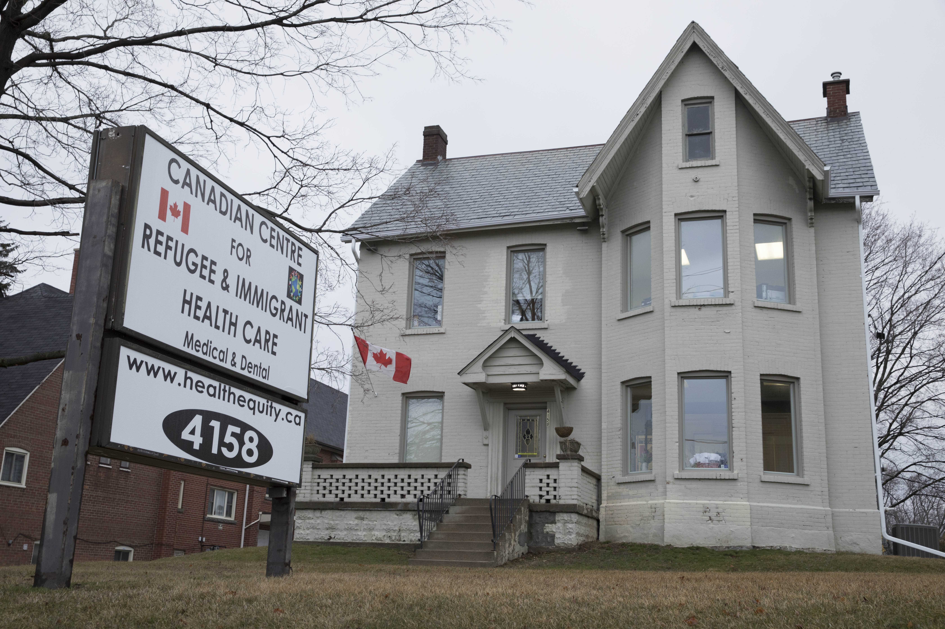
PICTURE OF THE CENTRE – DESCRIBE THE CENTRE AND WHAT WE DO

Slide 3
VOLUNTEER DRIVEN MEDICAL DENTAL CARE
MEDICALLY UNINSURED REFUGEE CLAIMANTS,
UNDOCUMENTED MIGRANTS, HUMANITARIAN AND SPONSORED
GOVERNMENT ASSISTED REFUGEES AND REFUGEE CLAIMANTS WITH INTERIM FEDERAL HEALTH COVERAGE WHO ARE TURNED DOWN FOR CARE BY PHYICIANS
VISA STUDENTS AND TEMP FOREIGN WORKERS
3 MONTH WAIT FOR OHIP
90% ARE WORKING – GENERALLY OFF THE GRID,
BELOW MINIMUM WAGE
NO HEALTHCARE ACCESS, INJURY OR OTHER PROTECTIONS

Slide 4
CURRENT WORLD SITUATION FORCED DISPLACEMENT, MIGRANTS AND REFUGEES
UNPRECEDENTED NUMBERS; ONE IN 25 ON EARTH IS NOW A MIGRANT – FORCED OR OTHERWISE
MORE ARE STATELESS AND DISPLACED NOW IN THE WORLD THAN AT THE END OF WW 2
WORLD NUMBERS STEADY 2001 to 2011
200% INCREASE IN REFUGEES AND DISPLACED PERSONS OF CONCERN FROM 2011 TO 2018

Slide 5
REFUGEE AND IMMIGRANT POLITICAL FOOTBALL The Good, Bad and the Ugly
ARE DEVELOPED WESTERN RECEIVING NATIONS WITH HEALTH CARE SYSTEMS HARDENING THEIR REFUGEE RECEPTION AND TREATMENT “POLICIES”?
HOW WELL ARE THEY MEETING THEIR SIGNATORY COMMITMENTS AND SOCIAL, ETHICAL RESPONSIBILITY TO THE CURRENT MIGRATION CRISIS?
HOW IS CANADA FARING –EG. HEALTH CARE ACCESS EQUITY?

Slide 6
WHO ARE PULLING THEIR WEIGHT?
85% OF ALL WORLD’S REFUGEES ARE HOSTED, GENERALLY IN CAMPS, IN A FEW OF THE WORLD’S DEVELOPING NATIONS (EG AFRICA, PAKISTAN, LEBANON, TURKEY)

Slide 7
LEIGH DAYNES, DOCTORS OF THE WORLD ON THE FRONT LINES OF THE EUROPEAN REFUGEE CRISIS……..
“At every stage of the refugee journey people are suffering, including after they settle in Europe. In the wake of this migration rise many European countries have focused their policies on minimizing and containing new arrivals, seemingly forgetting, or indeed ignoring, their duty to protect and care for people.”

Slide 8
POLICY AND POPULISM CONVERGE
Policy-driven access barriers to essential health services for forced migrants and refugees have persisted in wealthier receiving nations with advanced public health plans – Including Canada
As numbers grow and rising levels of medical needs appear, fear, xenophobic attacks, the erection of walls and fences, and restrictions to healthcare for asylum seekers takes hold. Unwelcoming efforts often drive refugees into the hands of smugglers and traffickers.

Slide 9
THE UNITED STATES OF AMERICA ….. The ground shifted
In the USA yesterday’s pioneers were refugees and immigrants who built the foundations of today’s strongest economy.
In today’s world migration crisis their descendants have replaced a practice of altruism with harsh national populace policies including travel bans, exclusion, protectionism, fear, open hostility to many groups – creating rejection and sowing societal division.

Slide 10
CANADA and POLICY
Prime Minister Justin Trudeau January 28, 2017 in response to the Trump immigration bans and populace rhetoric :
“To those fleeing persecution, terror & war, Canadians will welcome you, regardless of your faith. Diversity is our strength”
#WelcomeToCanada

Slide 11
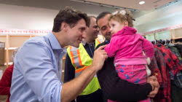
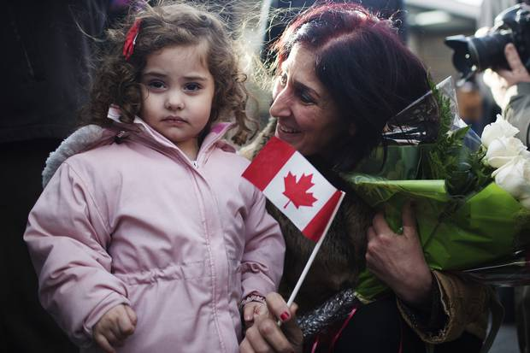
THEY LISTENED ( over 40,000 in 2 years)
THEY TOOK CANADA’S PROMISE AT FACE VALUE
THOUSANDS WALKED ACROSS OR HID IN TRUCKS
AFRICA, HAITIAN, CONGO, EAST AFRICA

Slide 12
INVITATION MEETS POLTICAL REALITY Canadian Policy…..
Allthough the human right to health has been set out in the 1948 Constitution of the World Health Organization as well as in subsequent international legal documents, in practice migrants and refugees often face formal and informal barriers in accessing healthcare and social services

Slide 13
INVITATION MEETS POLTICAL REALITY Canadian Policy…..
IMMIGRATION AND REFUGEE BOARD NOW REJECTING 45% OF NIGERIAN, AFRICAN REFUGEE CLAIMS
REJECTING 90% OF HATIANS CLAIMS
ACCESS TO CANADIAN PUBLIC HEALTHCARE DELAYED MONTHS, YEARS FOR MANY
- INCLUDING INFANTS, CHILDREN AND PREGNANT WOMEN

Slide 14
THE PRESS, POLITICIANS AND POLICY….
WHY ARE THESE ILLEGAL BORDER CROSSERS BEING ALLOWED IN ANYWAY?
THIS IS A CRISIS!
WHO IS ILLEGAL – WHO IS LEGAL – WHAT HAS LEGALITY TO DO WITH ACCESS TO BASIC HUMAN RIGHTS?

Slide 15
CANADIAN POLICIES THREATENING THE MORAL FOUNDATIONS OF MEDICAL CARE
A DISORGANIZED, DISCONNECTED, RIGID MISH MASH OF HARD TO UNDERSTANTD, COMPLEX MACRO LEVEL POLICIES, GENERATED AT ALL LEVELS OF GOVERNMENT CONSPIRE TO DENY ACCESS TO ESSENTIAL BASIC HEALTH CARE AND SOCIAL SERVICES TO THOSE NEWCOMERS WHO NEED THEM MOST
A LACK OF CLEAR, CONSISTENTLY APPLIED HEALT POLICY AT THE ACCESS LEVEL
WHAT IS AN EMERGENCY? WHY ARE CHILDREN TURNED AWAY?
HOSPITAL ERs ROUTINELY TURN UNINSURED AWAY
DEATH RATES HIGHER
AS DO WALK IN CLINICS AND MANY FAMILY DOCTORS – INCLUDING REFUGEES WITH IFHP COVERAGE

Slide 16
WHO ARE DENIED – IFHP and Refugee Claim Examples
THE CONGO. – Jonny, age 21 2015 -2018
GUATEMALA – Rose, Jorge and Julian. 2008 - 2018

Slide 17
HEALTHCARE POLICY CLINICAL CASE STUDIES (CCRIHC clinics)
DENIED, DELAYED, CANCELLED INTERIM FEDERAL HEALTH PLANS (FHP) –
PHYSICIANS REFUSING IFHP – CHARGING REFUGEES UP FRONT - COMMON
OHIP - REFUGEE CLAIMANTS OHIP INELLIGIBLE; PRs, RETURNING CANADIANS WAIT 3 MONTHS – SAMI, OHIP 1 WEEK BEFORE – BREECH – RIGID INTRANSIGENT POLICY
HUMANITARIAN APPLICATIONS – NO ELIGIBILITY, DENIED
UNDOCUMENTED MIGRANTS (OVER 200,000 – DENIED, NO ELGIBILITY
SANCTUARY CITIES – a few public health clinics
CHCs
OTHERS – “VISA” STUDENTS, INJURED TEMP FOREIGN WORKERS
PRIVATE HEALTHCARE REALITIES

Slide 18
IFHP “POLICY”
SYRIA – Haya, age 74 2013 – 2018
ETHIOPIA – Mariam, age 12 2016
AFRICA – HOPE, age 31 2018

Slide 19
CANADA’S “DREAMERS” NEVER CANADIAN ENOUGH?

Slide 20
MEDICALLY UNINSURED INFANTS AND CHILDREN NEW TO CANADA
DENIED ACCESS TO OHIP OR INTERIM FEDERAL HEALTH PROGRAM
32% OF THOSE WE TREAT IN OUR GTA VOLUNTEER CLINIC
FASTEST GROWING DEMOGRAPHIC SEEKING OUR CARE
12% 1 YEAR AND YOUNGER

Slide 21
HOW PRUDENTIAL IS THIS? HOW ETHICAL, HUMANITARIAN?

Slide 22
HOW PRUDENT? HOW HUMANITARIAN, FAIR?
PHPS: SARS / EBOLA NO SCREENING – CAME TO OUR VULUNTEER CLINIC
LONGER STAYS IN HOSPITAL
HIGHER DEATH RATES
HIGHER MORBIDITY RATES – EG TURNING PREGNANCY INTO AN EMERGENCY
ALLOWING TREATABLE DISEASE AND PAIN TO WORSEN ? TORTURE
PUSHING COSTS DOWN THE LINE TO OTHERS; INCREASING HOSPITAL COSTS
WORK OF THE GRID – CONSTRUCTION, CLEANERS, GTA GARMENT SWEAT SHOPS

Slide 23
CANADA
OUR POPULATION GREW 78 TIMES IN THE PAST 200 YEARS
WE ARE ALL FROM DIFFERENT PLACES. IT IS WHAT DEFINES US
MOST ADMIRED NATION . 5TH MOST PROSPEROUS
4/5 FUTURE YOUTH AND WORKERS MUST COME FROM AWAY

Slide 24
HEALTHCARE ACCESS DENIED ……Is this what defines us now?

Slide 25
IN 2008 THE LANCET HAD THIS TO SAY ABOUT EUROPEAN COUNTRIES AND THEIR POLICIES ON REFUGEE ACCESS TO HEALTH CARE
“The current stance of European countries makes a farce of the UN conventions that they have all ratified, which include guaranteeing the right to health care for undocumented migrants. All member states should detach health care from immigration control and take the necessary measures to ensure that access to health care for undocumented migrants is uniformly implemented by national and local authorities.

