Slide 1
Health Programming and Practice
in the Context of Older Adult Care

Slide 2
Agenda
The changing nature of care for older adults
How CHATS Helps
Responding to needs: A community sector approach to two areas of challenge:
  ALC
  Tenancy Risk Reduction for Seniors
Current challenges in the sector
How can we better influence health policy and program planning

Slide 3

This baby could live to be
142 years old
Centenarians are the fastest-growing
age group in
York Region. Between 2011 – 2016 the number of people over the age of 100 increased by 62.5%!

Slide 4


The Boomer Effect

Slide 5

I may be a senior, but so what? I’m still hot.
- Betty White
Betty White, 94

Slide 6


People are living longer
That’s good news!
Is 2016 seniors accounted for a record-high share of York Region’s population, rising to 14.6% percent of the population from 11.7%
Additionally, the number of seniors in York Region has increased faster (33.4%) compared to the city of Toronto (13.1%) between 2011 - 2016

Slide 7

Province ill-prepared for senior health care ‘crisis’, experts warn
Thu., Apr 14, 2016 | By Lisa Queen

Slide 8
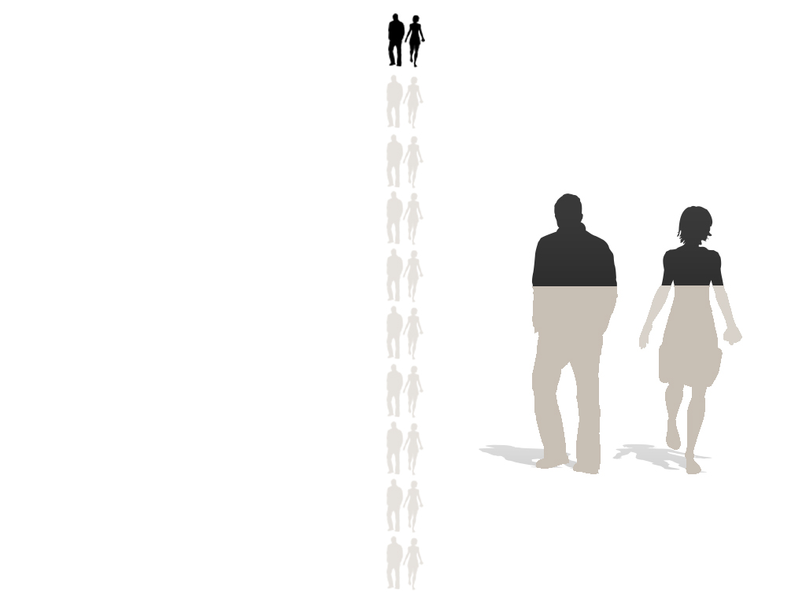
Sober Senior
Thoughts
The top 10% of older
Ontarians account for
60% of health spending
Yes, people are living longer, but with more chronic conditions.
One-third of Canadians between 65-74 are disabled
Two-thirds over 65 take 5 or more prescriptions
$
$

Slide 9

Most older adults prefer
to age at home
Choose to maintain health, independence and dignity
Home care more cost effective ($55/day) vs LTC ($130/day) vs hospital ($1000/day)
However:
The right care at the right time must be provided, not ‘undercare’
Age, health, wealth and the presence of an informal caregiver can affect ‘stay at home’ decisions

Slide 10

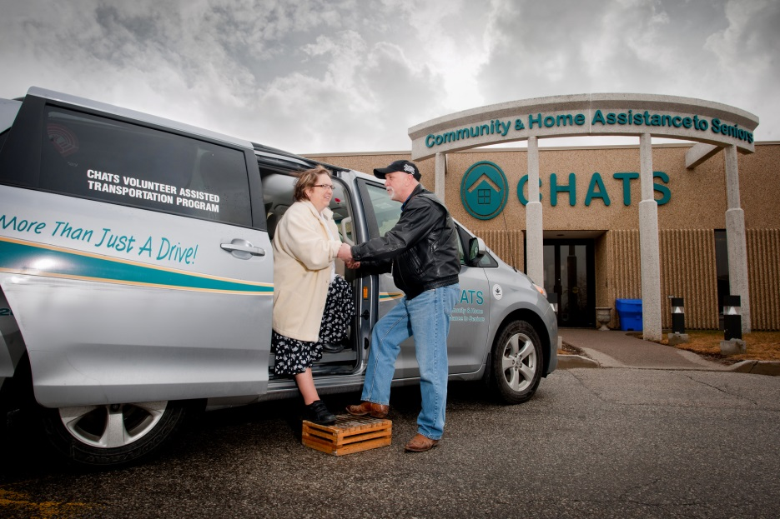
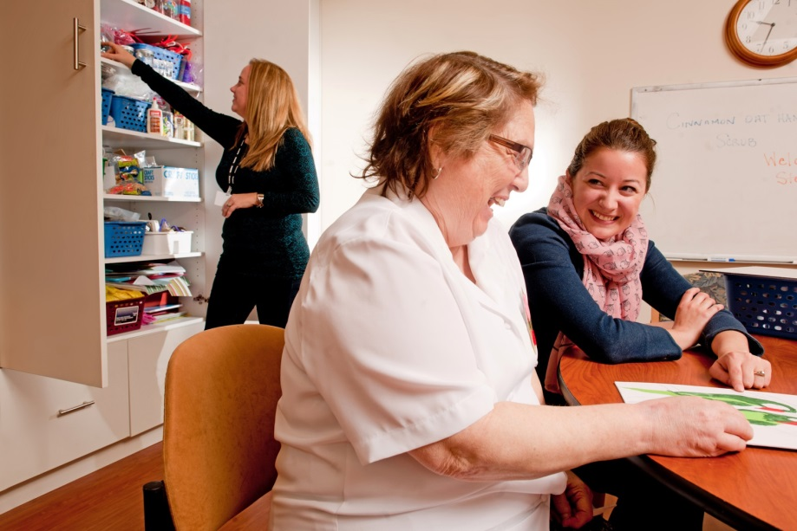
CHATS’ Vision
Older adults can live independently, safely and well at home

Slide 11
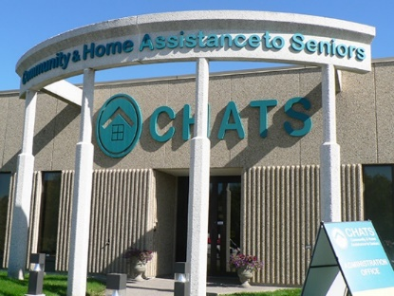
What is CHATS?
Charitable organization that provides home and community service to older adults and adults with age related conditions in York Region and South Simcoe
Accredited by international standards organization
Personal care and support, programs and services to enable independent living and family caregiver support
Tailored individualized care plans meet unique needs of persons served
  “basket of services”
  “wrap-around care”
Emphasis on “Wellness Framework” – social determinants of health as well as physical, mental, social, spiritual
Programs and services are available in 26 languages (interpretation service available)
Moderate fees geared to income
Provided by 320 staff and almost 500 volunteers

Slide 12

Who CHATS Serves
The “average” CHATS’ client is female between the ages of 75-84, living alone in central York Region.
Let’s call her Mary.
Although Mary represents the majority of CHATS’ clients, she doesn’t show the full story of the population that we serve...

Slide 13


Persons Served
8,300 clients in York Region and South Simcoe
71% of CHATS’ clients are female and 29% are male
Ages 55-64 (11%), 65-74 (21%), 73-84 (38%), 85-94 (27%), over 94 (3%)
Top Cultures and Languages supported: English, Italian, Farsi, Russian, Cantonese, German, Hindi, Urdu, Bengali, Tagalog.
41% of CHATS’ clients live alone, with 29% living with a spouse and 22% living with family and 8% are living with friends.

Slide 14
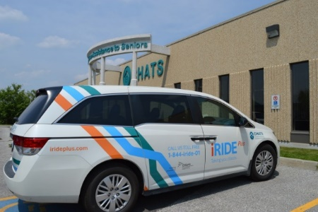
How CHATS Helps
Transportation: Provided to and from medical appointments, errands, shopping, CHATS programs.
Diversity Outreach Programs: Social and wellness activities, each tailored to cultural and language needs: Chinese, Italian, Russian, Iranian & South Asian
Adult Day Programs: Provide clients with a variety of social and wellness activities, companionship and lunch.
Homemaking: Home Support Workers assist with the activities of daily life including, light cleaning, laundry and meal preparation
Caregiver Respite / Personal Care: PSWs provide in-home care when caregivers require extra help and/or a much needed break.
Telephone Reassurance: CHATS volunteers give seniors a check in call.
Meals on Wheels: Home-style nutritious meals delivered right to a senior’s door.

Slide 15
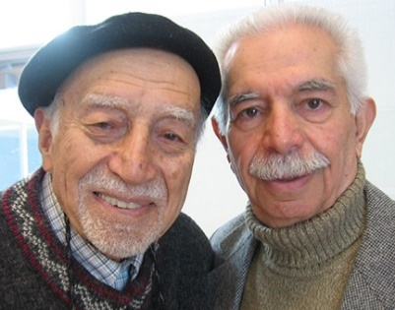
How CHATS Helps
Home at Last: Patients are driven home from hospital and a Personal Support Worker helps them settle in.
Home Adaptation and Maintenance Program (HAMP): Regular maintenance and accessibility renovations.
Tenancy Risk Reduction Service for Seniors: Provides support to seniors living in squalor due to hoarding behaviours.
Caregiver Support & Education: Provides referral, support groups, workshops, individual counselling and web-based resources to caregivers of seniors in York Region, and South Simcoe.
Assisted Living: Provides 24/7 scheduled and unscheduled assistance to eligible seniors who live in a designated supportive housing building or in their own homes within a specific geographic boundary.

Slide 16
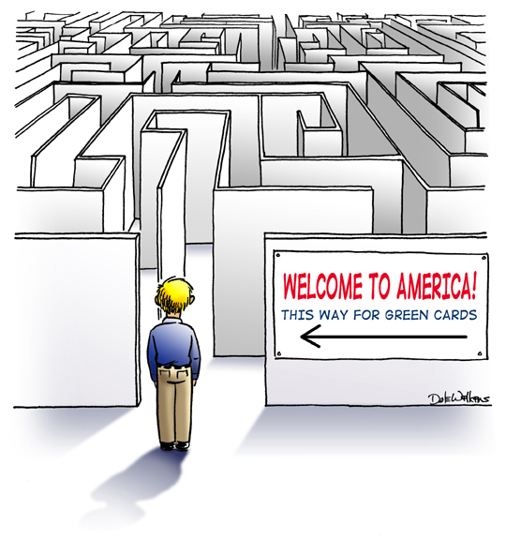
Case Study #1 - ALC: The Problem and the Genesis
Medically stable frail elderly are occupying acute care hospital beds due to insufficient community supports.
This way for services
for seniors
Notes:
Problem:
Medically stable frail elderly are occupying acute care hospital beds due to insufficient community supports
**how does HAL address social determinants of health issues: transportation, social isolation component – choose to have respite or have a friendly visitor, program available regardless of income, the referral component that HAL supervisor does, assesses need of clients, and perhaps refer to needs of clients for social services.
**Can you outline how HAL meets the characteristics

Slide 17
Research Showed…
Ontario Health Quality Council 2007 Annual Report identified four causes for backlog in hospitals:
  Shortage of LTC beds
  Lack of proper processes in hospitals to ensure timely discharge
  Lack of community services for recently discharged patients, and
  Problems transferring patients

Slide 18

What Was Needed?
A straight-forward, user-friendly process to divert people from EDs or discharge them from acute hospital beds, and connect them to more community-supports and social determinants of health.

Slide 19
And then Came Home At Last (HAL)
  Originally funded under ER Diversion funds 2008, then “Aging at Home” strategy money, now “base”
  Designed under a “lead agency” model (2 co-leads, CHATS & Lumacare), with lead agency allocating referrals for community support services to appropriate partner agencies
  Intended to improve system level collaboration amongst hospitals, Community Care Access Centres (now LHIN Home & Community Care), and community support service agencies

Slide 20

Intended Outcomes
Initial Outcomes:
Ensure that seniors do not remain in hospital any longer than needed.
Facilitate safe and timely discharge.
Coordinate community services to achieve smooth transition from hospital to community.
Prevent unnecessary re-admissions.
Common Objectives:
Improve patient flow
Improve patient discharge experiences and provide seamless transitions from hospital to home
Improve patient health outcomes
Reduce readmissions to hospital emergency and in-patient departments
Improve collaboration among hospitals, LHIN Home & Community Care, and community support agencies
Build sense of security and reduce anxiety for patients
Notes:
20

Slide 21
CHATS’ Home At Last (HAL)
Originally funded under ER Diversion funds 2008, then “Aging at Home” strategy money, now “base”
Intended to improve system level collaboration amongst hospitals, Community Care Access Centres (now LHIN Home & Community Care), and community support service agencies
Partner with four regional hospitals
    Mackenzie Health Southlake Regional Health Centre
    Markham Stouffville Hospital Stevenson Memorial Hospital
Partner internally within hospital
    Patient Flow Navigators Patient Care Coordinators
    Social Workers GEM Nurses
    Nurse Practitioners
Partner with other CSS Agencies (cross border transfers, training, sharing of best practices)

Slide 22
The Home At Last (HAL) Service
Provides a safe and smooth transition from hospital to home for older adults and persons with special needs following inpatient admission or emergency room visit, at no cost to client
Reliable transportation and helps client remain safe and comfortable at home by remaining with client until settled
Way home: pick up Rx, groceries, small med equipment or supplies
Ensures home environment is safe: falls hazards, physical barriers, phone, heat and electricity working
Provide 2 frozen “Meals on Wheels” per client
Referrals daily 8:30 – 4:30, 7 days/wk, stat holidays included
Follow up call within 5 business days to review service and provide coordination/linkages to community support services
HAL “follow up hours” one time, within two week period after discharge (respite, bathing, meal prep, medical visit, socialize, etc.) Average 3 hours @ no charge

Slide 23
HAL: Client Eligibility
  55+ or those with special circumstances who require assistance on discharge (excluding same day surgery)
  Must be medically stable and able to direct and manage own care, such as meds, insulin injections, oxygen, etc
  Able to manage med routine with minimal reminders
  Mobile and weight bearing with minimal one-person assist. Able to get into a vehicle or home with assistance of one person
  Residence can include retirement home, but not LTCH

Slide 24
HAL: Results By the numbers
Client Profile:
  Home at Last served 1129 unique clients (Apr 2017- Mar 2018)
  Average age of a client is 77 years old
  Average time of day that referrals are received is 12:35 pm
  305 were ER Discharges
  56 were Chemo patients
  324 clients live alone
  High degree of client satisfaction
YTD 2017/18
  Total volumes (transportation, meals, home help, visiting) 9,647
  Expenses $321k
  FTEs 5.1

Slide 25
HAL: Success Factors
  Focus on Quality
  Takes a holistic approach to client experience and outcomes
  Positive relationship with partners and stakeholders
  Communication and education is ongoing in all areas of hospital
  Logistics of the program are well established (MoW in hospital, simplified 2 pg referral form)
  Dedicated HAL PSWs: become familiar/build relationships with hospital staff
  PSWs also drive vehicles for greater efficiency and client comfort
  CHATS Clients are informed about HAL ahead of hospital visit to enable expectation and better comfort knowing there is support on discharge
  Having direct funding

Slide 26
HAL Ongoing Challenges
Levels of Awareness and Training of Hospital and LHIN Home & Community Care Staff (need for “in hospital” champions)
Clarity of Referral Process and Respective Roles for HAL referral
Quality and metrics not included as part of hospital accountability
Breakdown of communication regarding patient status
Degree of Collective Ownership/Accountability for HAL outputs and outcomes: understanding the value of social determinants of health as part of care continuum
Notes:
Program concept sounds simple…bring someone home from hospital and get them settled and linked up to community services if needed.
However, the program is complex to implement because it involves responding quickly to 3 sets of fluctuating and multi-faceted needs:
Needs of the client
client recovery rate
client’s confidence in recovery process
availability of caregivers to support
Needs of the Hospital
inpatient bed and ED utilization
MD availability to sign-off on discharge orders
multi-disciplinary involvement in discharge coordination and documentation
Community Service/PSW availability for delivery of HAL service

Slide 27
Testimonials
“Since (HAL) started, we noticed dramatic changes in our d/c flow! This program responded to one of our major barriers-transportation home….as well as …to bring patients home safely by settling them in their own environment as comfortable as possible….With such a great service we aren’t dependant on family members’ work schedules anymore. We hope government will continue to run it as long as possible, since it takes such enormous weight (timely discharges) from hospital “shoulders””. Zelda F, Patient Flow Coordinator
“Home At Last has been a service that often goes beyond my expectations. Dealing with the frail elderly can be complicated and this program ensures not only the timely transportation back to the home, but a wonderful settling in by the PSWs….[They] will advise me of how a transfer went and can alert me to issues within the home environment that I may not have been aware of, ie limited food, issues with cleanliness or clutter—this helps to facilitate connections to community resources to further support the senior/caregiver.” Annie H, GEM Nurse, Emergency Department
“My mother is on oxygen and I had no way of getting her home and up the stairs into our house, along with the oxygen she badly needed. Cheryl [PSW] was an absolute angel. Even above all the things she did for my mother, the most important to me is that she kept Mom calm and reassured her. That meant the world to me.” Mrs. B, family caregiver

Slide 28




Case Study #2: Tenancy Risk Reduction for Seniors

Slide 29
Why was this needed?
York Region has one of the lowest rental vacancy rates in the province, with some of the highest housing costs
Subsidized housing (ie. York Region Housing) has long wait lists
Expansion of CHATS’ Assisted Living services revealed increasing situations where clients were living in “squalor” presenting health and safety risks to both clients and workers
Community supports were available, but not in a coordinated, cohesive manner

Slide 30
And then came CHATS’ TRRSS
In 2014, CHATS first teamed up with YSSN and VHA , with one year funding from the Region of York, to design and deliver a program to support seniors with hoarding issues at risk of losing their tenancy.
  This first small project supported just under 40 seniors and showed some excellent initial outcomes.
  Sample size small yet we were able to demonstrate that this collaborative model of providing:
      Intensive case management, physical clutter reduction and therapy intervention improved quality of life.
In 2015, the same partnership applied for and was successful in receiving funding from the Ontario Local Poverty Reduction Fund for a two year initiative.
This longer and larger pilot included partners at York University, who are formally evaluated the program.
In 2017, CHATS applied for funding from York Region and United Way, to carry on the program for a further three years

Slide 31
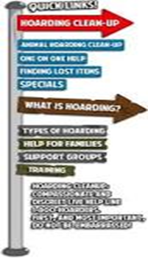
Research and Evaluation
Funding through the Ontario Local Poverty Reduction Fund enabled CHATS to test the program model as a way to reduce poverty and homelessness.
With the focus of formally testing/evaluating a model of service for transferability and applicability to other jurisdictions, the project had a very strong research component.
CHATS and our partners at YSSN and VHA worked closely with the Program Evaluation Unit at the York Institute for Health Research at York University.
The research focused on testing a Model of Change that addressed the following two questions:
  Does building community capacity to identify and support vulnerable seniors keep seniors in their homes longer?
  What aspects of a multi-ponged approach are most effective in improving the health and well-being of seniors identified as having problematic hoarding behaviours?
The research included both an individual component and a systems level component.

Slide 32
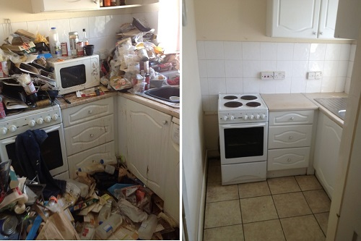
Program Components
Program is delivered over the course of approximately six months for each client.
Components include but are not limited to the following:
  Assessment and Care Coordination (CHATS)
  Geriatric Mental Health Case Management
    (YSSN)
  Physical Clutter Remediation (CHATS)
  Intensive Cleaning (CHATS/VHA)
  Occupational Therapy (VHA)
  Education and Training (All)
  Client Advocacy with Landlords (All)

Slide 33
Geriatric Case Management
Psychosocial rehabilitation approach
  Utilize bio-psycho-social model for depressive symptoms & hoarding behaviour
  Many of these seniors experience isolation due to the state of their home (refrain from inviting people over, embarrassed, ashamed).
  CM to assist them in building up their social networks again and connecting them with others.
  Emotional support – family issues/trauma that has led them into their current situation (family breakdown, mental health symptoms)

Slide 34
Geriatric Case Management- Models of Change
Harm Reduction:
  Every step is a step to be recognized and celebrated
CBT Techniques:
  Providing a weekly goal planner sheet to create goals about what tasks they would like to complete (regarding taking care of the home) between the time that the HSW comes again
  Discussing the importance of certain items, what it means to them, along with the positives that will come out of them discarding that object.
  Support client to reevaluate their thinking about the actual vs. imagined importance of the item and to gain a new perspective on the realistic consequences of not having that item

Slide 35
Client Stories
Every client’s level of hoarding/clutter behaviour varies.
One client not only had cluttering behaviour inside the home, but also outside (by-law-enforcement officer involved due to neighbourhood complaint)
  CM assisted client is ridding of all clutter on front lawn (interlocking bricks, statues, fountains, miniature fixtures, etc.)
  Client was connected with HAMP to assist in whipper-snipping front yard
  Client is now working on landscaping her yard to her liking to the best of her ability and complaint was not filed.
80 yro male, with mobility issues living in subsidized housing referred by staff at Housing York & Fire/EMS. Issues identified: occupant could not exit home in emergency, and EMS could not enter quickly; fire potential, risk of falls, access to phone restricted. Client claimed clutter due to lack of storage.
  Individualized cleaning schedule set up; book shelves installed; sorting/organizing/cleaning
  Approx 4 months work completed and client discharged.
  Three month follow up with post service assessment: clutter rating reduced to avg 2 out of 9; space to walk freely through unit
  Client now has ongoing homemaking every two weeks to support maintenance of improved conditions

Slide 36
Current Challenges in the Sector
Staffing is reaching critical stage:
  PSWs and HSWs crucial for service delivery
Changing demographics:
  Older adults’ migration to northern communities
  Rurality impact on ability to reach and serve
  Demand for culturally-specific services and workers
  What will the Boomers expect for their own care?
Competition for funding and who decides priorities

Slide 37
How Can We Influence Policy and Planning?
How can we better position/profile community services within an integrated health care/social services delivery context?
What do we need to do better/differently?
How can we influence policy decision-makers?
  Evidence-based research
  Resource reallocation

Slide 38

It`s not how old you are, it`s how you are old.
- Jules Renard
Mick Jagger, 75

