Slide 1
GRI Standards
October 4, 2017

Slide 2
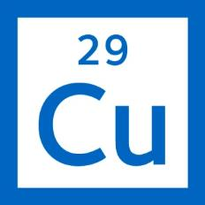
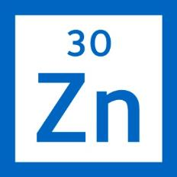
Canada’s Largest Diversified Resources Company
# 1 Producer of steelmaking coal in North America
# 2 Seaborne exporter of steelmaking coal globally
Top ten copper miner in the Americas
#3 zinc miner in the world
Building an energy business
Implementing a comprehensive sustainability strategy
Safety is a core value

Slide 3
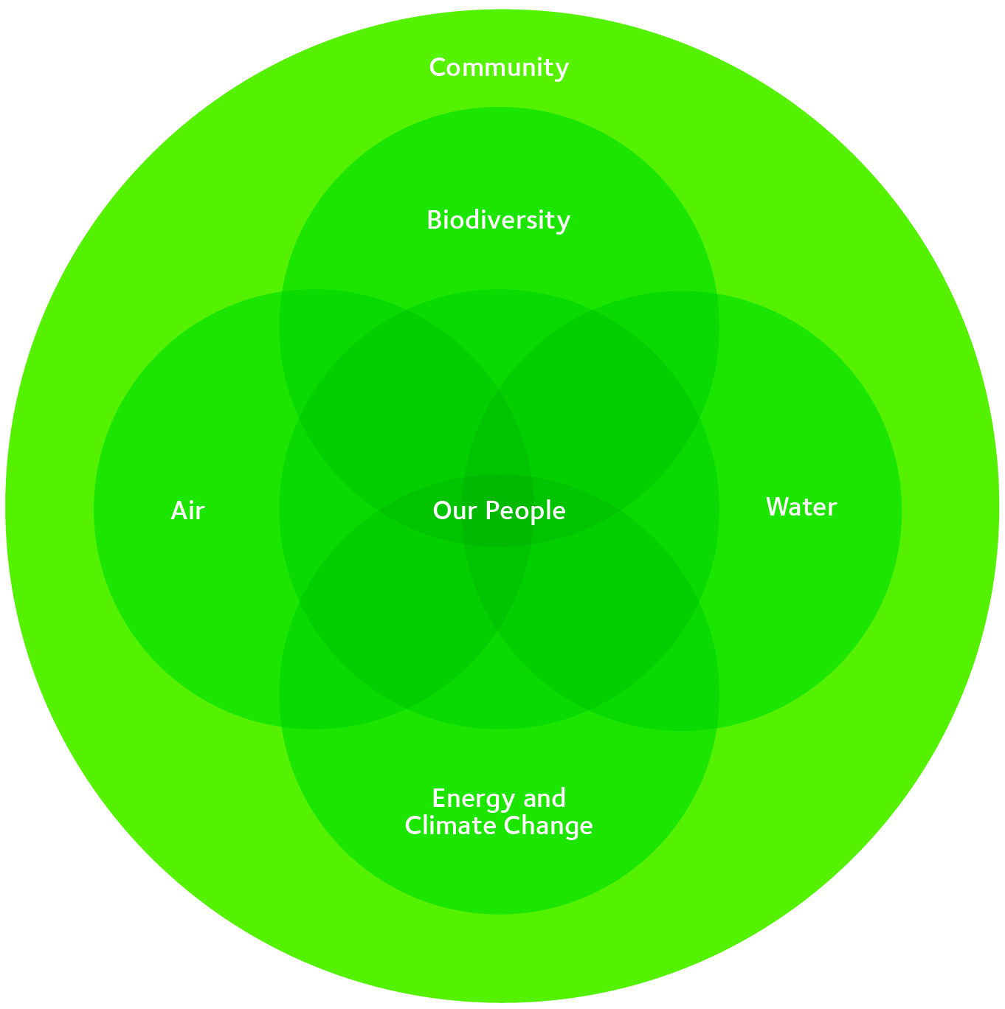
Approach to Sustainability
In 2011, we launched our formal sustainability strategy
Organized around 6 focus areas representing our most material sustainability challenges and opportunities
Achieved each of our short-term sustainability goals in 2015 and set new short-term goals to 2020
In 2015, we updated our long-term 2030 goals and vision for each area

Slide 4
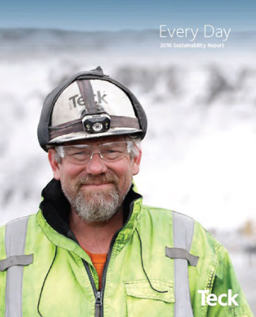
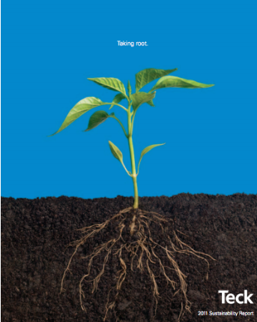
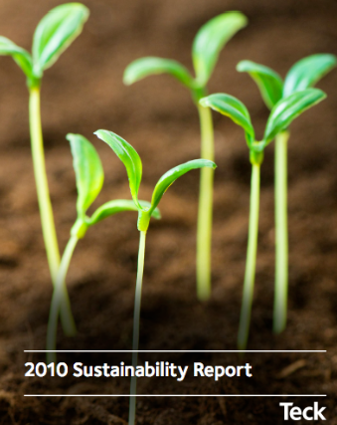
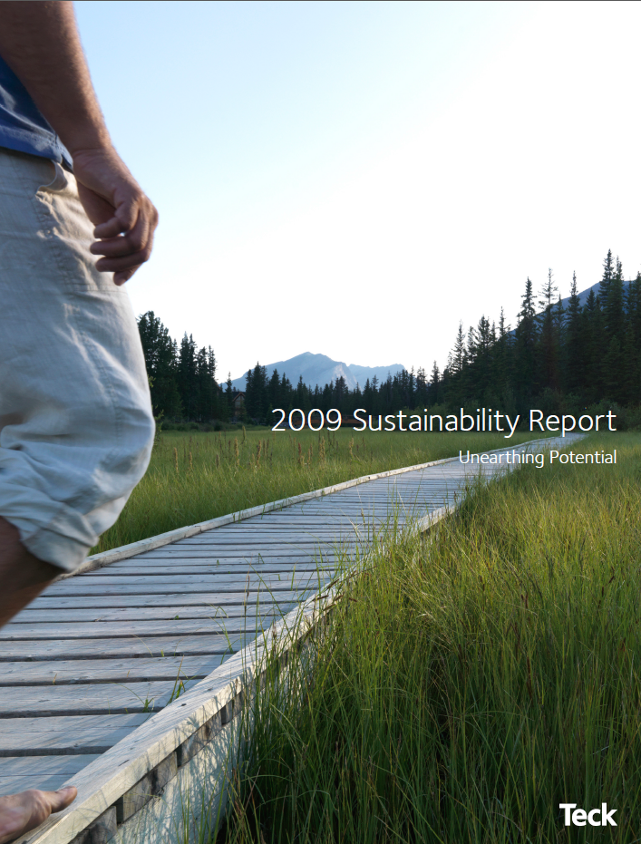
History of Sustainability Reporting

Slide 5
Approach to Sustainability Reporting
Release sustainability report
Respond to questionnaires based on report (DJSI, FTSE4Good, Corporate Knights)
Evaluate reporting and management approach based on rankings, requirements and internal/external trends
Refine the reporting process
Distribute summary of trends that may impact management approach and/or evaluation of performance
Site and corporate data collection and report writing
Changes to management approach and/or evaluation of performance

Slide 6
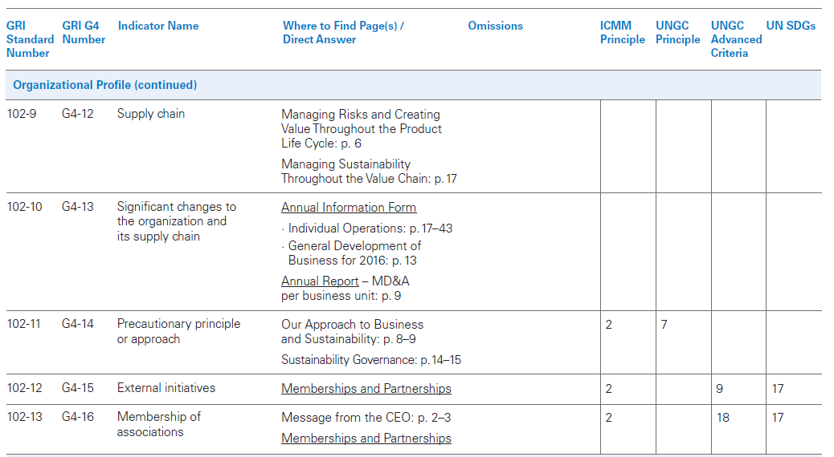
Transition to GRI Standards

Slide 7
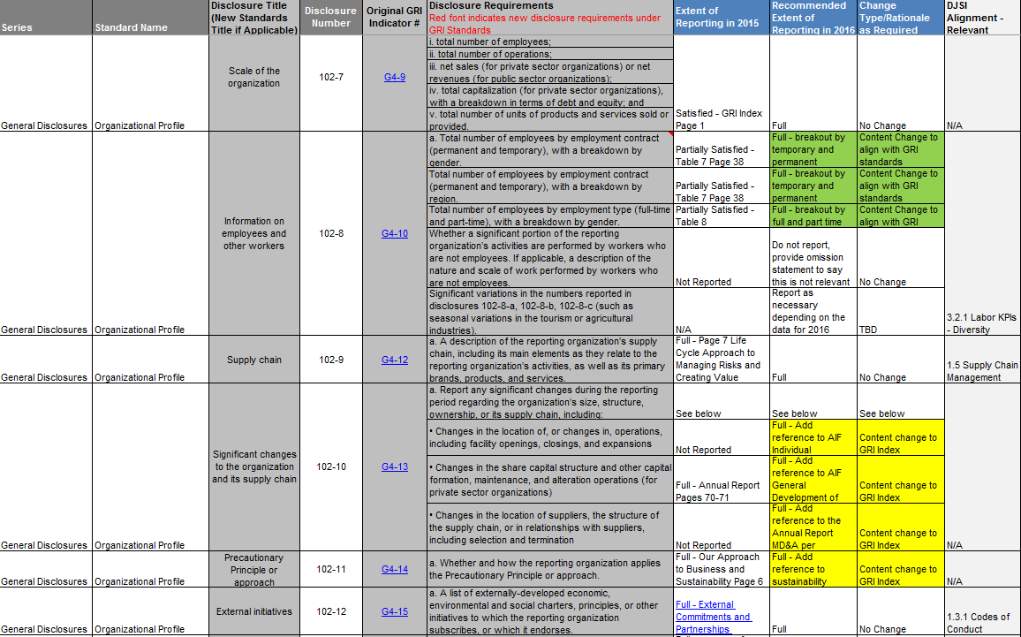
Data Mapping

Slide 8
Internal Consultation

Slide 9
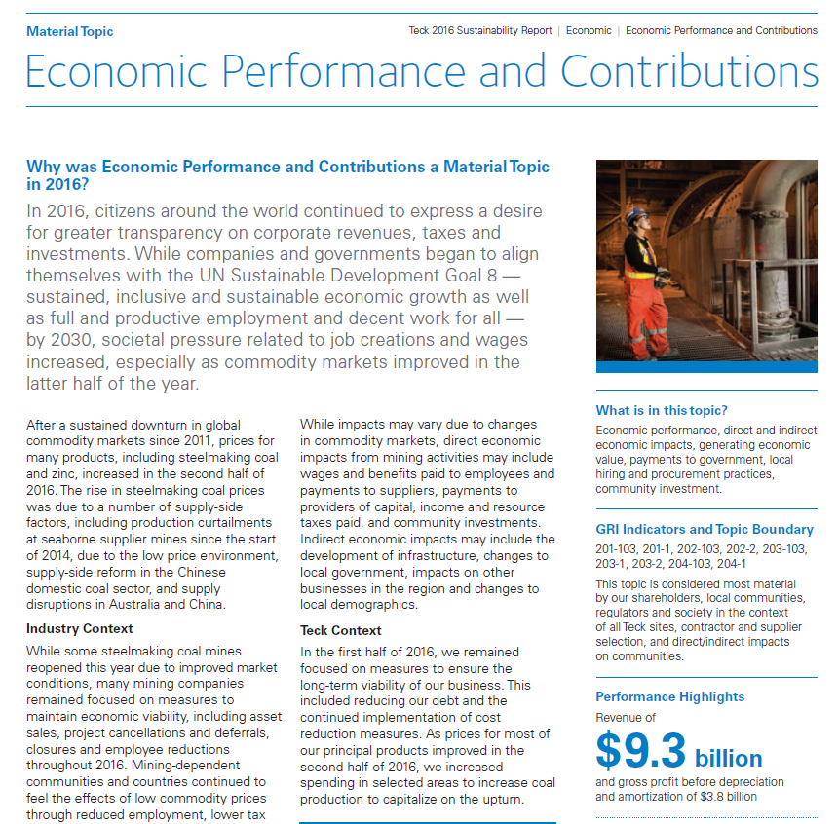
Surfacing the GRI Standards During Writing

Slide 10
Key Learnings
Map the current GRI indicators against the Standards to identify changes required
Cross reference changes against other reporting expectations or requirements.
Summarize and communicate recommended changes to subject matter expertise and senior leadership.
Incorporate GRI language into draft and final report.
Ensure assurance provider is aligned on the Standards.

