Slide 1
GRI Standards
Alyson Genovese
Head of Corporate/Stakeholder Relations – North America

Slide 2
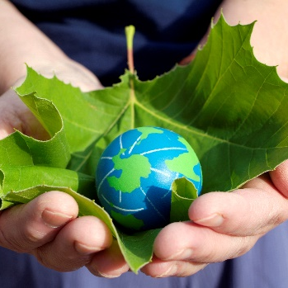
Why are Organizations Reporting?
Demand for Transparency
Desire to Build Trust and Reputation
Need to Manage Risk and Create Opportunities

Slide 3
About GRI
Our Vision
Create a future where sustainability is integral to every organization's decision making process.
Our Mission
Empower decision makers everywhere, through our sustainability standards and multi-stakeholder network, to take action towards a more sustainable economy and world.
We Believe:
Transparency is a catalyst for change
Notes:
A bit quickly about GRI.
Most widely used reporting standards in the world. 90+ countries. 26,000 reports in SDD. Approx 70% reports issued use GRI tools.
Referenced in 40+ government regulatory bodies and 30 stock exchange guidance to companies on reporting
At our heart, we believe in the transformative power of transparency. Things can’t happen until stakeholders trust information that is being disclosed by organizations. Without information, smart decisions can’t be made.

Slide 4
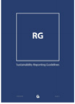
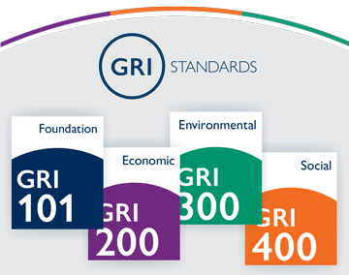
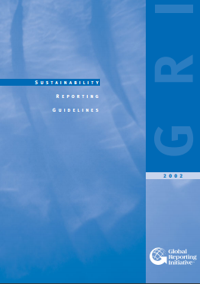
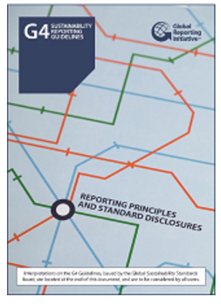
GRI and the Evolution of Reporting
2016
GRI Standards
2013
G4 Guidelines
2011
G3.1
2006
G3 Guidelines
2002
G2 Guidelines
2000
G1 – First ever Guidelines released
1997
GRI Founded in Boston by UNEP, Ceres, and the Tellus Institute
Notes:
History of GRI mirrors that of corporate sustainability expectations overall, GRI grew as demand from stakeholders did.
For those of you in the field in 1997, you may remember that time… increasing demand for environmental impact reporting. GRI was created as a joint project of Ceres, Tellus Institute and UNEP to create an accountability mechanism to ensure companies were following CERES Principles for responsible environmental conduct. Investors were the framework’s original target audience. Social and economic impacts were largely seen as separate – occurring through philanthropy, community relations, government affairs, etc.
Shortly thereafter, the demand grew to include not only environmental impacts, but social and economic.
The challenge was to create this global framework that would be applicable to organizations of all sizes and types around the world
The first set of reporting guidelines was issued back on 2000, and over the next 13 years GRI went on to develop and release 4 additional versions of reporting guidelines. As demand grew – and expectations of stakeholders grew – the guidelines evolved accordingly. The most recent of these, the G4 Guidelines, were released back in 2013. The G4 guidelines are now used by thousands of organizations in more than 90 countries around the world.
So over the last 15 years, we’ve seen sustainability reporting evolve from a niche to a mainstream business practice. In a 2015 KPMG survey, 92% of the Global 250 are currently doing sust. Reporting, and of these 74% use GRI in their reporting process.

Slide 5
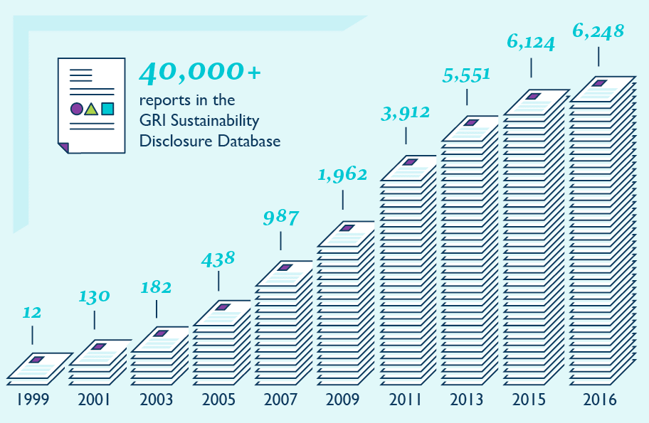
Reporting Continues to Increase

Slide 6
Sustainability Reports issued by S&P500
Source: Governance & Accountability Institute, 2016
Notes:
We’ve seen tremendous growth since 2000, particularly in the past 6 years in the United States. In the USA last year, we received about 600 reports into our Sustainability Report Disclosure Database.
But with just about 4300 publicly traded companies in USA right now (source: JPMorganChase), not to mention number of privately held companies, nonprofit organizations, municipalities using the GRI tools, much work remains to be done to ensure that companies are actively and transparently disclosing their impacts on the larger world around them.
Source: http://finance.yahoo.com/news/jp-startup-public-companies-fewer-000000709.html

Slide 7
Sustainability Reporting, Canada vs Globally
Per publication years 2012-2016
Data from GRI’s Sustainability Disclosure Database, Retrieved 19 September 2017
Notes:
Sustainability reporting = all the report types we register on the Database (being non-GRI reports, citing-GRI reports and GRI reports)
GRI reports = sustainability/Integrated reports based on the GRI Standards or previously existing Sustainability Reporting Frameworks for which there is a GRI Content Index available.
Citing-GRI = Indicates sustainability/Integrated reports that make explicit reference to being based on the GRI Guidelines (G3, G3.1 or G4) but for which there is no GRI Content Index.
Non-GRI = All sustainability/integrated reports that do not fall under the categories of GRI-Standards or GRIReferenced should be included under this Non-GRI classification. Additionally, Non-GRI indicates sustainability/Integrated reports in which the organization discloses information on its economic, environmental, social and governance performance, but there is no reference to being based on the GRI Guidelines or GRI Standards.

Slide 8
GRI Sustainability Reporting Standards
Enhances the global comparability and quality of sustainability information
Creates a common language for organizations and stakeholders
Enables referencing in policy initiatives

Slide 9
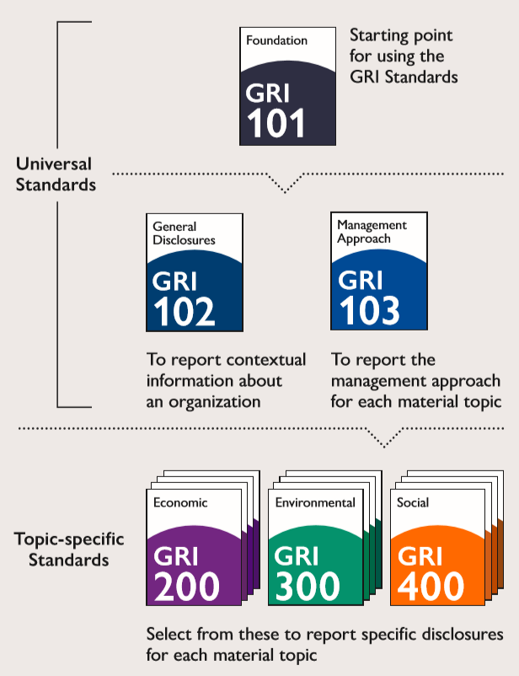
GRI Standards
The set of GRI Standards includes:
3 universal Standards
33 topic-specific Standards
Organizations select and use only the relevant topic-specific Standards, based on their material topics
Notes:
So what GRI is doing is trying to make access to reporting much easier, streamlined, consistent and comparable. The creation of the GRI Standards in 2016 moved out of these frameworks into an international, independent and trusted set of global standards.
Faster response times for new reporting measurements. There are ever-changing demands for new and improved disclosures. The Standards have a flexible, modular structure; so they can stay timely and relevant for reporters.
Standards that are even more suitable for referencing in policy initiatives. The new structure and formalized standard-setting activities allow the Standards to be even more widely-referenced by governments and regulators.
A global common language for non-financial information. The Standards provide a single framework with the flexibility to meet all sustainability reporting needs – from comprehensive reports to disclosures on specific topics.
Standards developed with true multi-stakeholder contributions and rooted in the public interest. This is a unique selling point of the Standards: the fact that they have contributions from diverse stakeholders, and are a free-to-use public good.

Slide 10
Alyson Genovese
genovese@globalreporting.org
603.834.5585
260 Madison Avenue, Suite 204
New York, NY 10016

